Slide 1
SAP Build Process Automation Training on SAP BTP for professionals
Video mode only
www.anubhavtrainings.com

Slide 2
Agenda
Who is this course for
Mapping the developer persona with the training
Build BPA
Understanding SAP BTP Build portfolio; A brief history of Build Process Automation
Our Use case
Consider a demo use case and implement the same in the session
FAQs
Some of your questions regarding the module

Slide 3





Who is this course for
Abramo
SAP Solution Architect
How SAP Build process automation on BTP can help to best fit to organizational needs
Vladía
SAP Process Expert
Understanding key capabilities around SAP Build process automation
Zakir
SAP developer
Build and deploy end to end business processes according to needs with Robotic process automation capability
Kelly
Workflow dev
How to transform on-premise workflows to latest SAP build cloud-based automations and bring the manual efforts down

Slide 4






Expectations
01
02
03
04
05
SAP BTP
Understanding SAP BTP and Setting up Account
SAP Build
SAP Build portfolio and Services for BPA and Work Zone
Process Authoring
Create end to end build business processes with decisions and forms
Process Intelligence
Add Robotic bots to process, configure visibilty
Advance features
Deploy standard processes with Built-in content
4

Slide 5
Timeline
BRF +
A webdynpro based rule management application in ERP
iRPA
Robotic process automation with desktop-based application
2000
2019
2022
ECC Workflow
Classic workflows to orchestrate business process
BTP Cloud Workflow
SAP BTP based workflow modeling and execution
SAP Build
Build process automation combining iRPA and Cloud workflow
2006
2020

Slide 6
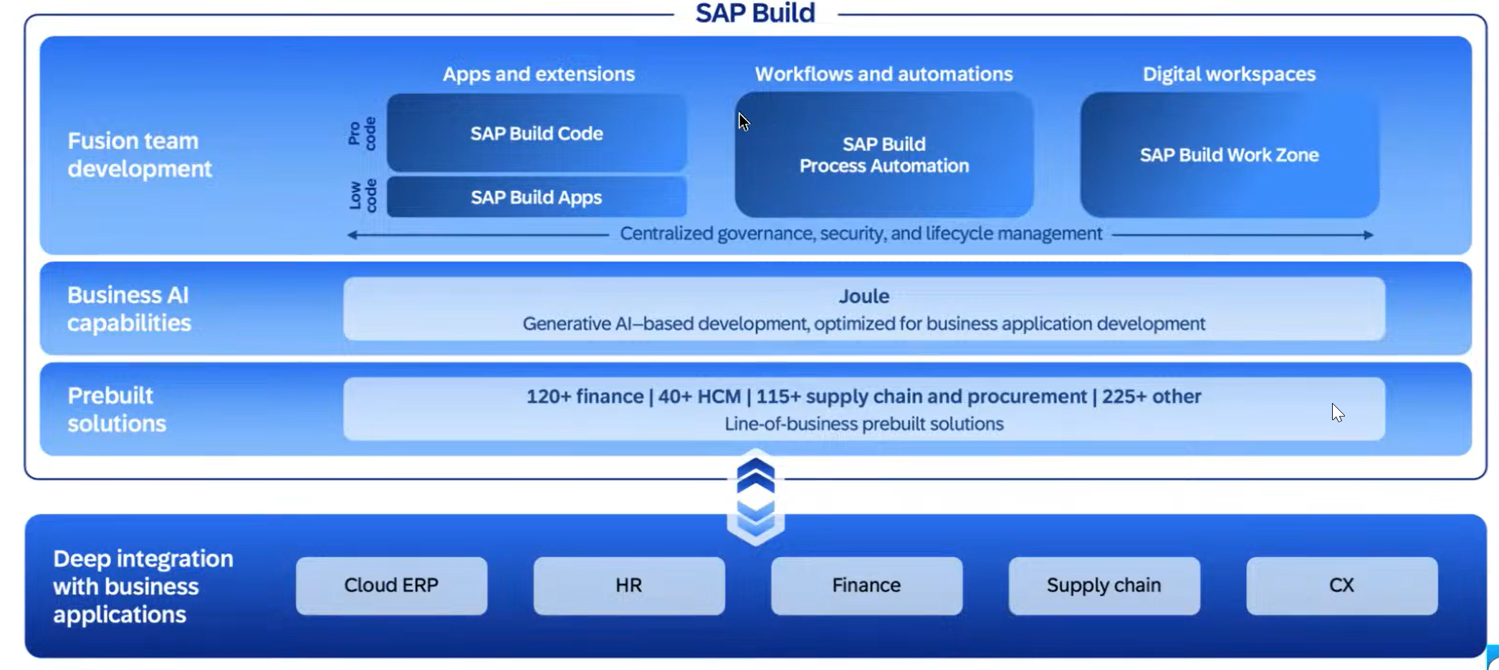
What is SAP Build

Slide 7
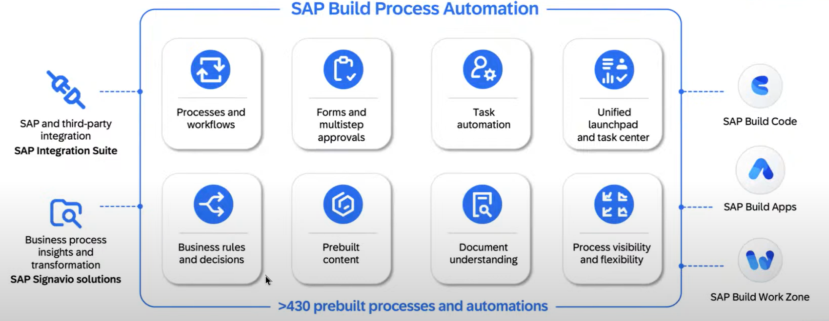
Key Capabilities

Slide 8

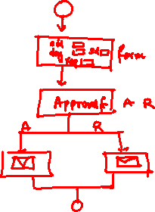
Our use case
Design a Process in SAP BTP for an employee to request for leave and manager should approve the same.

Slide 9

www.anubhavtrainings.com
FAQs
Do I need to have prior knowledge of SAP BTP or Cloud Foundry?
No, We will cover the Cloud Foundry and BTP foundation in this course for you.
How much programming knowledge is required to learn BTP Build BPA?
Only Basic programming skills are required.
I am an ABAP Consultant; Can I learn SAP BTP Build process automation?
Yes, you must, because for all the future cloud projects to achieve process automation will be on SAP Build
How much deep knowledge of BAS is required?
No prior experience is required, we will cover setup and administration of BAS tool in the course.
What about server access?
The server is Free from SAP for 90 Days, We will use SAP BTP Trial Account including setup of RPA desktop agent.
Would you cover Build Apps also in this course?
No, SAP Build apps is a separate course but the SAP Build Work zone is covered in current module.
9

Slide 10
www.anubhavtrainings.com
FAQs
Do we also cover Cloud Connector and using Actions to call S/4HANA ?
Yes, we will cover both topics including calls to Any on-premise systems, open APIs, and CAP applications.
How of this course do we spend time on Pre-built content processes?
We will cover end to end 2 big scenarios of pre-built content which includes S/4HANA, Destination, Fiori Apps, and Integration suite.
Do I need prior OData Service experience?
No, we will provide one complimentary OData session
Can I also take the course in video mode as the times do not suit me?
Yes, You can even check the video after the class
Do you cover RPA also in the course?
Yes, the Build workflow and RPA both are combined in the current course with EXCEL, PDF, SAPGUI and Fiori Automations.
How to join this course?
Email us at contact@anubhavtrainings.com for signing up!
10

Slide 11
Chapter 1: SAP BTP Introduction
Difference between On-premise and cloud system
What does the cloud offers?
Advantages of SAP BTP
BTP product overview
[Hands-on] Setting up BTP account
BTP pricing model
BTP Account Overview
BTP Environment, Subscriptions, Services
BTP Service Discovery Center

Slide 12
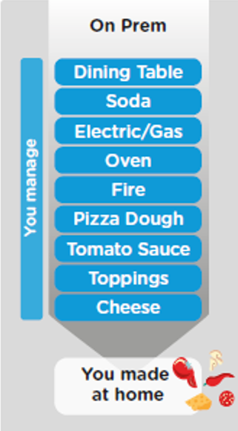
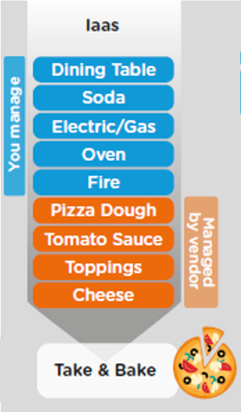
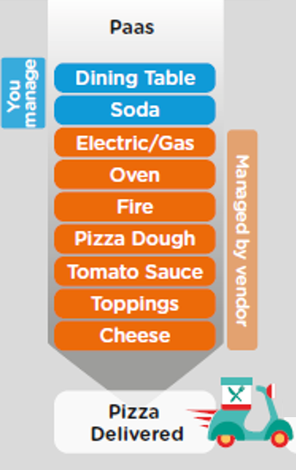
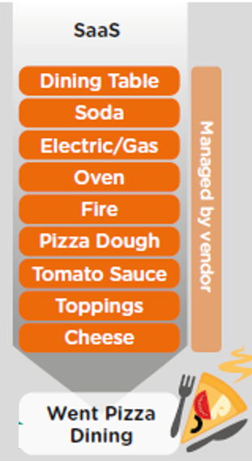
Difference between On-premise and Cloud system

Slide 13
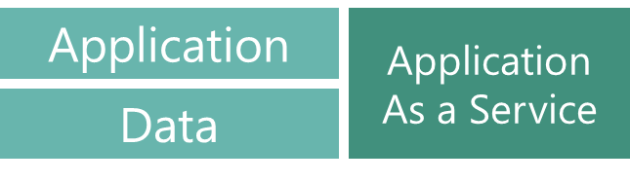

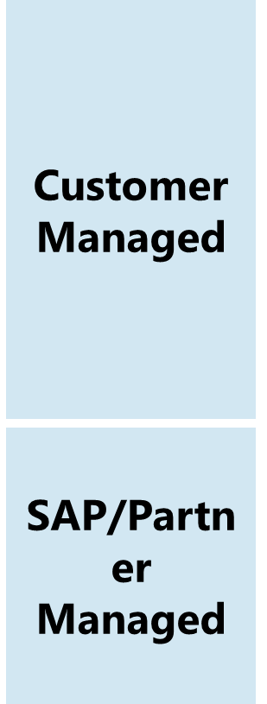
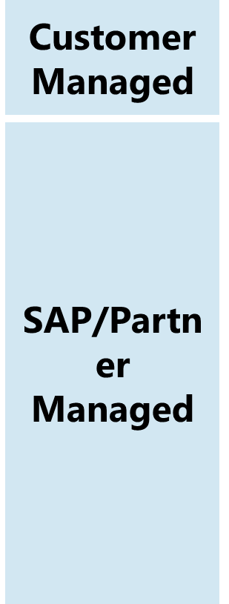

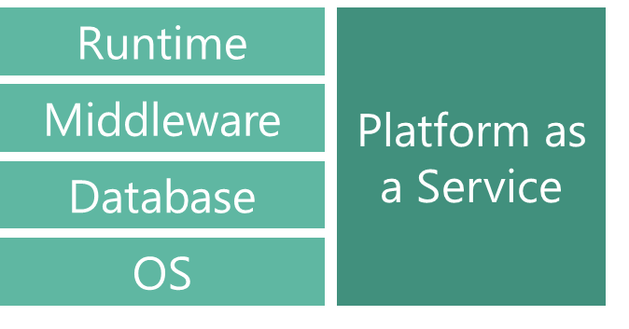
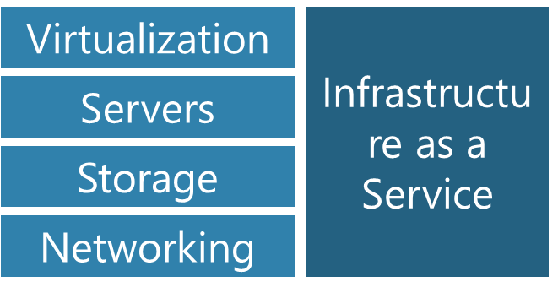
What are the cloud offerings?

Slide 14
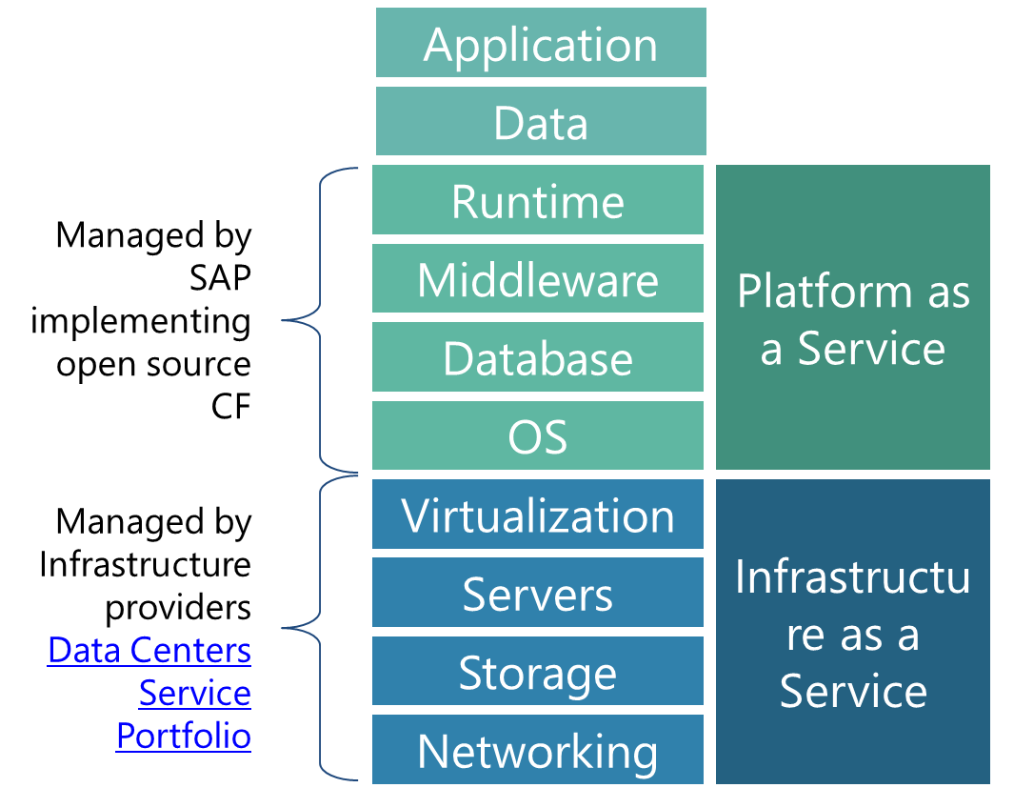
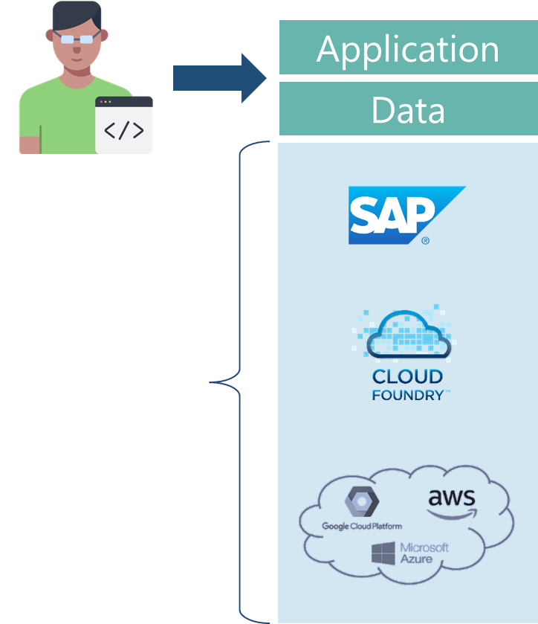
What is BTP and advantage?
Fully ready landscape with reusable services
Scalability
Elasticity
Low TCO

Slide 15
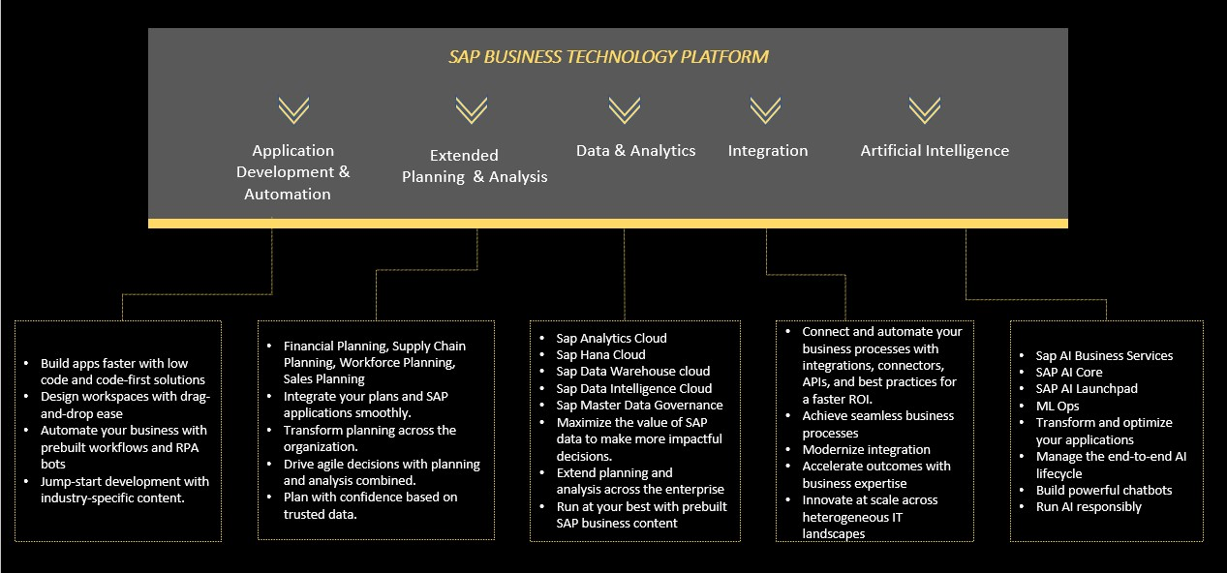
BTP portfolio

Slide 16
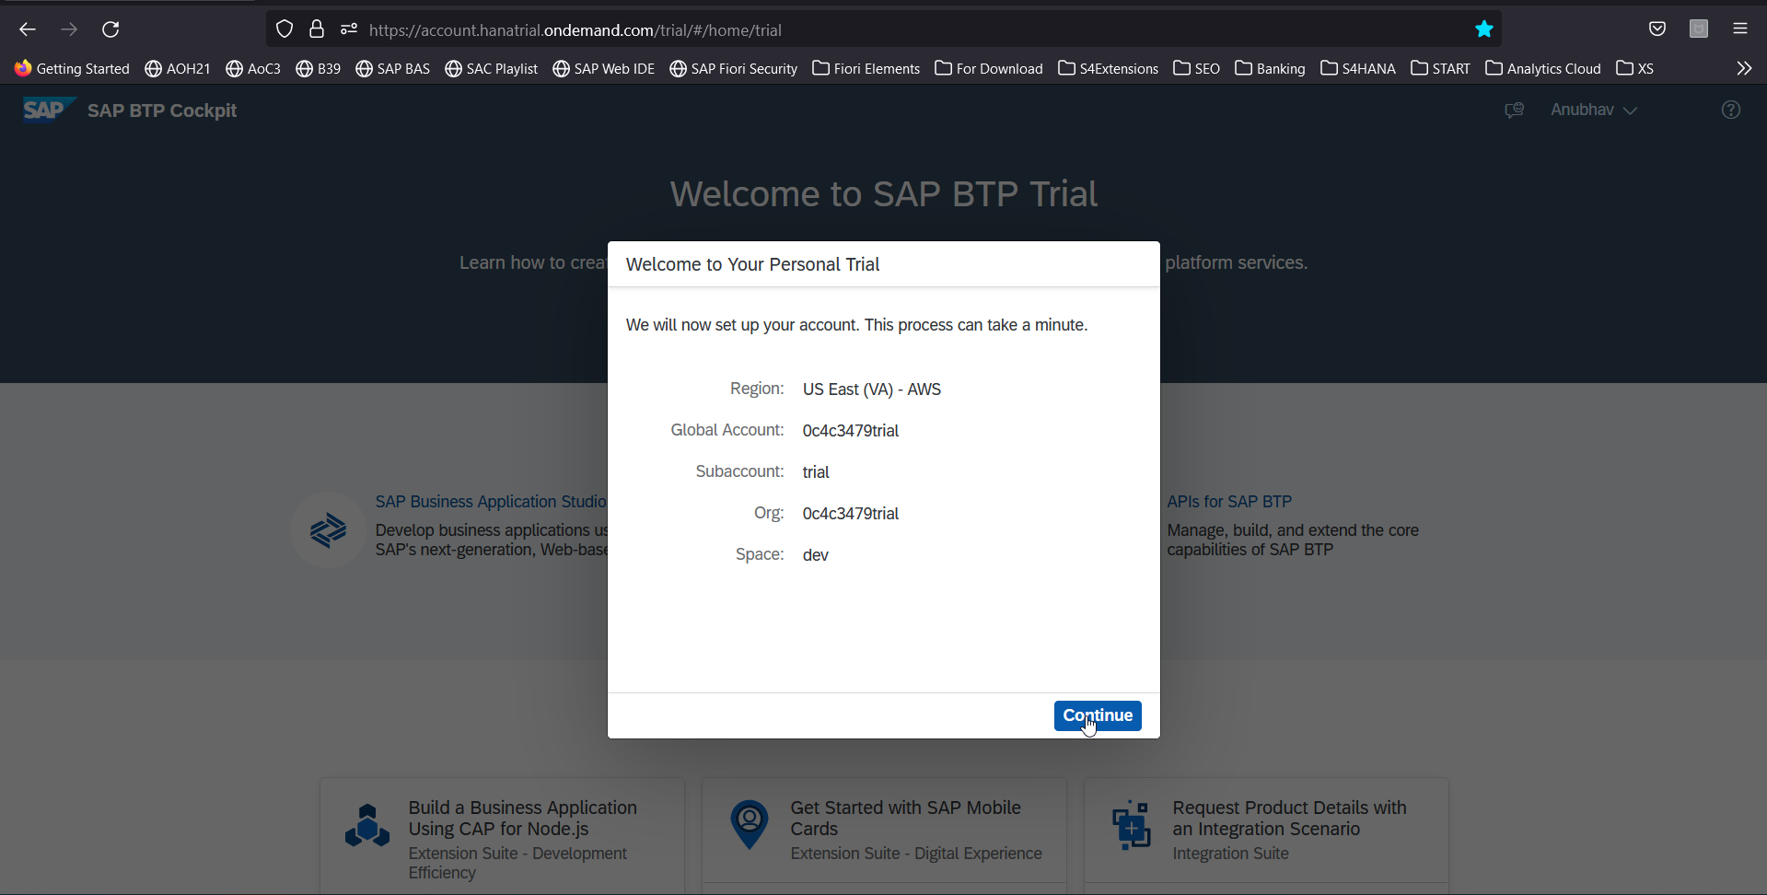
Let’s Create a BTP Account
Create your free BTP Account
https://account.hanatrial.ondemand.com/trial/#/home/trial
What is BTP?
BTP stands Business technology platform, it is a PaaS in the cloud provided by SAP to design, develop, package, build, deliver and manage applications, integrations and business process automation.

Slide 17
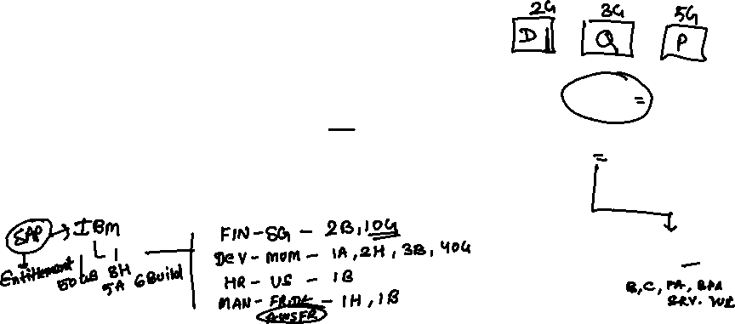
BTP Account Structure
Backing Services
Global Account
(Representation of customer for billing purpose)
Sub Account
(per region)
Specialized service offerings
Represents LoB
Space quotas
1 *
1 *
Space
1
*
Apps

Slide 18
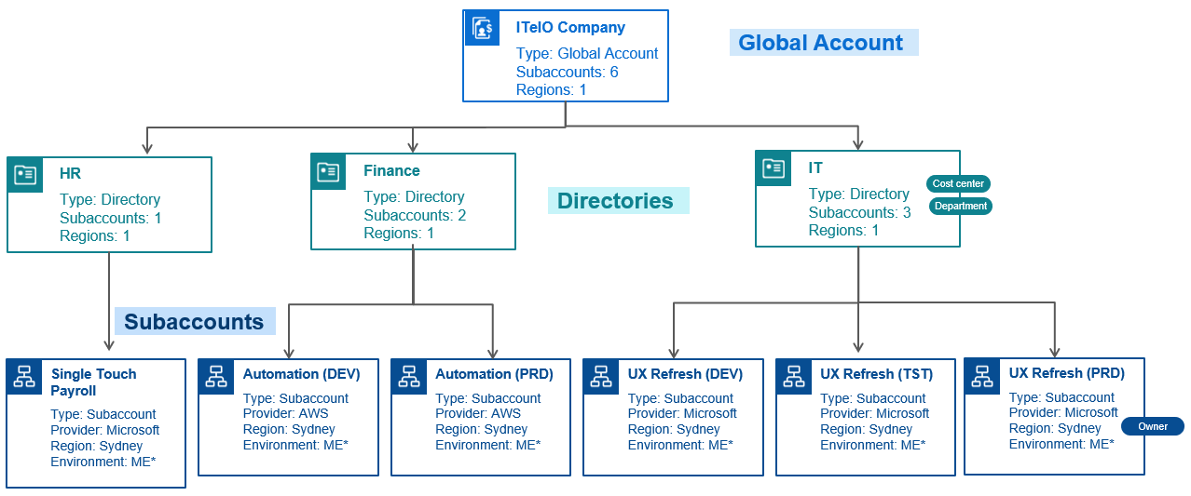
BTP Account – Administrator’s view

Slide 19
BTP Environments, Subscriptions, Instances
Environments
Environments constitute the actual platform-as-a-service offering of SAP BTP that allows for the development and administration of business applications. Environments are anchored in SAP BTP on subaccount level.
SAP BTP offers three environments: ABAP, Cloud Foundry and Kyma. Some existing customers still have Neo, but this is no longer offered.
Subscription based services
You will also see these ones called software as a service (SaaS), or multitenant applications. The experience here is that you subscribe to the service, and in return you receive a URL, from which you can access that service. Opening the URL brings you to a web application from which you can leverage the service. This is how other SaaS like SuccessFactors or S/4HANA Cloud work as well. They are also enabled at a subaccount level, and are independent of the environments. You don’t need to have Cloud Foundry enabled to subscribe to SAP Launchpad Service, for example.
Examples include Launchpad, SAP Business Application Studio, Cloud Integration, Process Automation…
Instance based services
These are the purest services. They provide a specific functionality, like databases, connectivity, authentication…. You connect your application to them to leverage that functionality. These services don’t provide a UI to manage them. Instead, they rely on API to connect to applications and other services and provide their services. They are provisioned inside an environment, so they are environment specific. Each environment has its own organization (for users and applications): In Cloud Foundry, instances are created inside a space. For Kyma, instances are created inside a namespace.

Slide 20
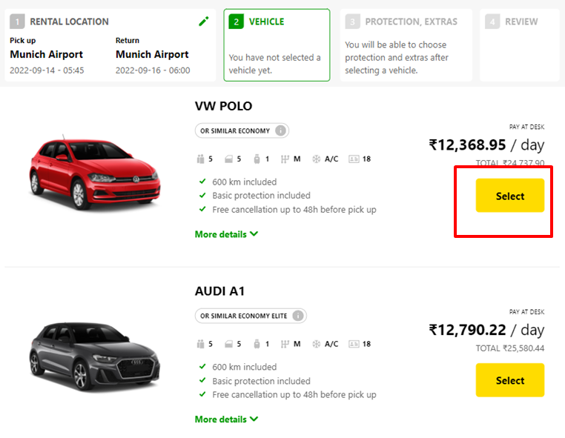
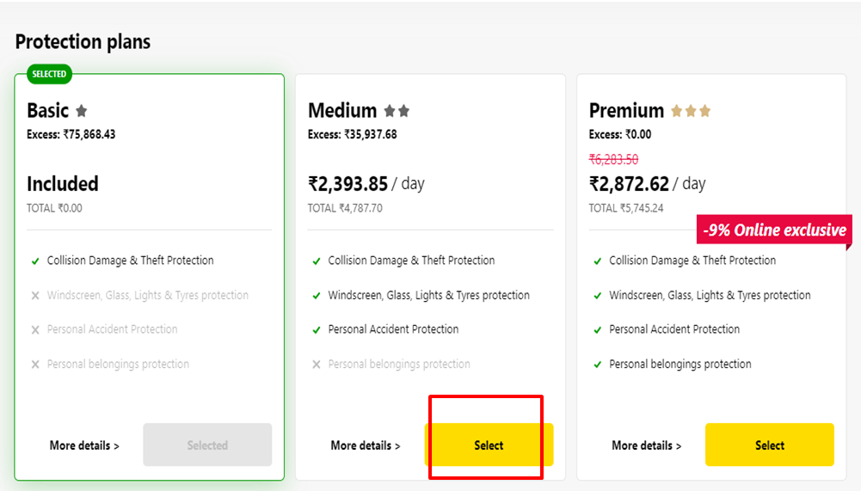
What is Backing service/ service instance
Each service has one or more service plans available. A service plan is the representation of the costs and benefits for a given variant of a particular service. For instance, a database may be configured with various "T-shirt sizes", each of which is a different service plan.
Choose Your service
Backing Service
Select Plan
Service Plan

Slide 21


How the Instance work?
Car key to use Car
Service Key to Consume Service instance
Actual Car
Service Instance

Slide 22
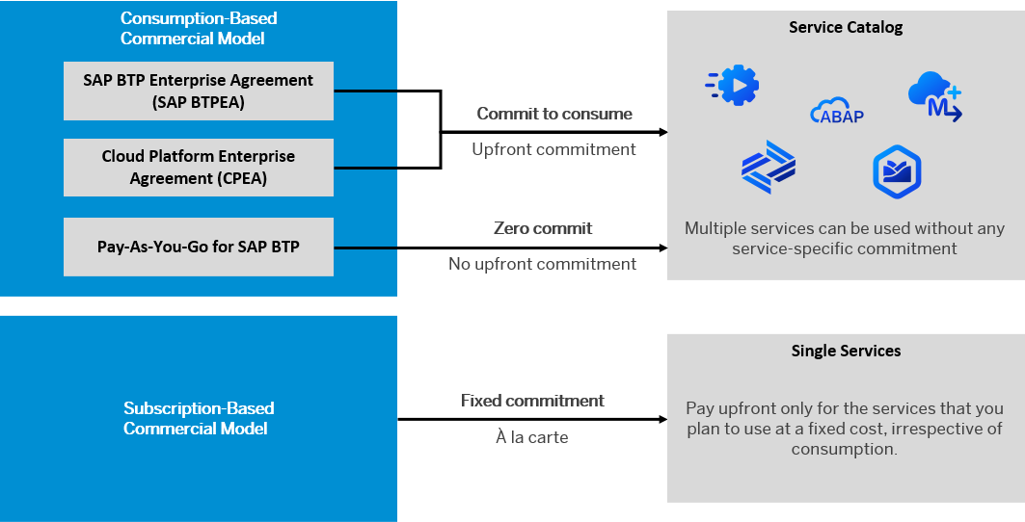
BTP Subscription Models

Slide 23
How many Services BTP offers?
The SAP Discovery Center is a relatively new site hosted by SAP for developers and architects to find the services hosted by sap in SAP BTP and their respective service plans available.
It will also help technical team to identify the data center availability and cost associated with each service.
https://discovery-center.cloud.sap/#/serviceCatalog

Slide 24
Chapter 2: Introduction to SAP Build
What is fusion team?
Key role of a developer with LCNC development
What is SAP Build?
SAP Build offering
What is Build work zone
[Hands-on] Setting up SAP Build work zone

Slide 25
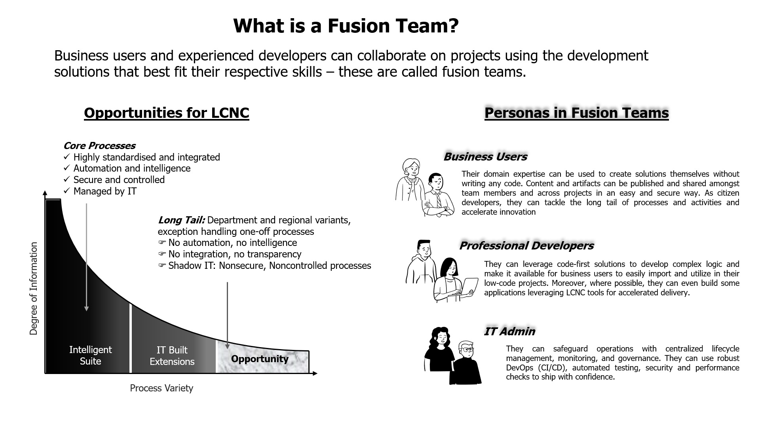
What is fusion Team?

Slide 26
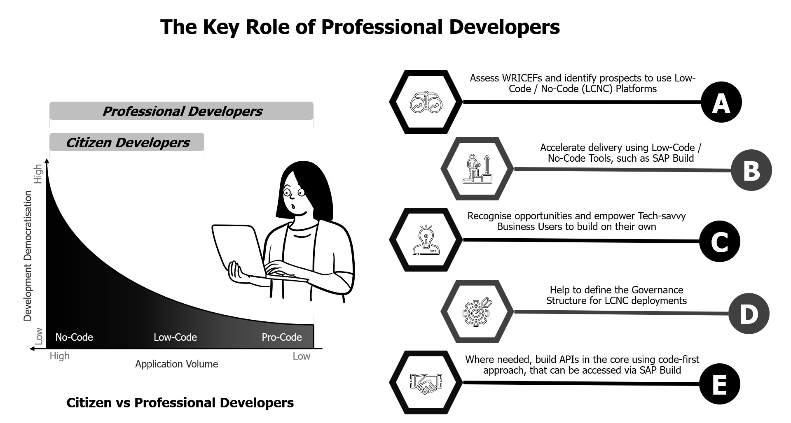
Key role of professional developers?

Slide 27
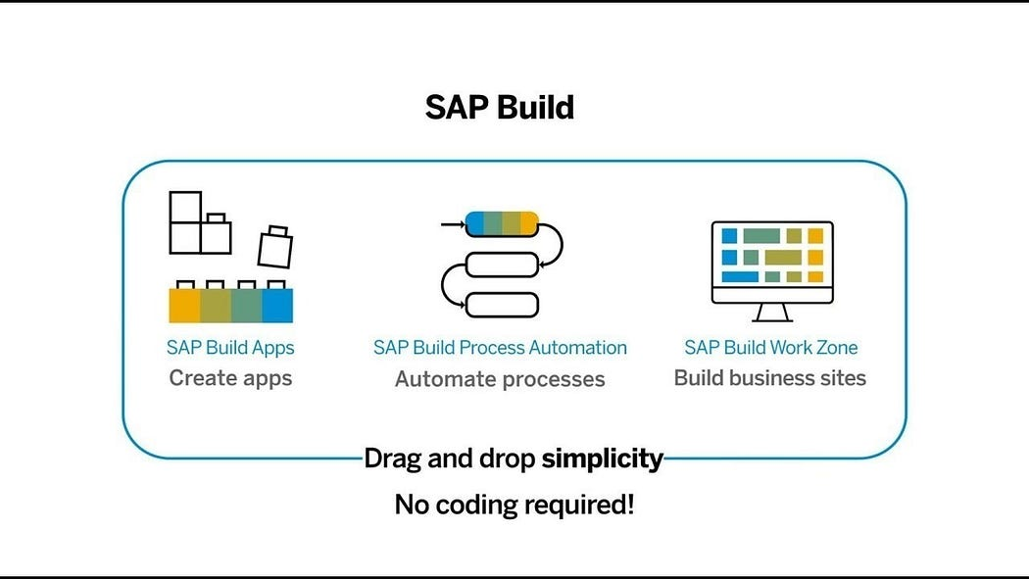
What is SAP Build?
SAP Build is a user-friendly low-code/no-code platform within the SAP Business Technology Platform (SAP BTP), designed to empower users to create, customize, and enhance applications, automate workflows, and build business sites without the need for advanced coding skills. It includes three primary components:

Slide 28
SAP Build Offerings?
SAP Build Process Automation
SAP Build WorkZone
SAP Build Apps
Purpose: Simplify the development of enterprise applications through an intuitive interface. Key Features:
Visual Development: Create UI, workflows, and logic using a drag-and-drop approach.
Prebuilt Templates: Leverage templates for common business scenarios.
Data Integration: Connect seamlessly with SAP and external systems through APIs.
Multi-Channel Deployment: Develop apps for both web and mobile platforms.
Collaboration Tools: Facilitate teamwork during the app-building process. Use Cases:
Developing HR onboarding solutions.
Building custom KPI tracking dashboards.
Creating customer-facing applications for feedback collection.
Purpose: Streamline business processes using workflows and robotic process automation (RPA). Key Features:
Workflow Automation: Manage approvals, notifications, and document routing automatically.
Prebuilt Bots: Access a library of bots to handle repetitive tasks like data entry.
Business Rules Management: Easily define and update business logic.
Process Visibility: Track and optimize workflows in real-time.
AI Integration: Utilize AI capabilities such as document recognition for enhanced automation. Use Cases:
Automating invoice approval workflows.
Managing employee leave requests.
Connecting and streamlining repetitive processes across systems.
Purpose: Design tailored business sites and portals for employees, customers, or partners. Key Features:
Prebuilt Templates: Quickly create branded portals.
Content Integration: Combine apps, dashboards, and workflows in a unified portal.
Role-Based Access: Customize content and permissions according to user roles.
Collaboration Features: Incorporate chat, forums, and knowledge-sharing tools.
Mobile-Friendly Design: Ensure accessibility across all devices. Use Cases:
Developing employee self-service platforms.
Creating customer support portals.
Building collaboration hubs for partners.

Slide 29
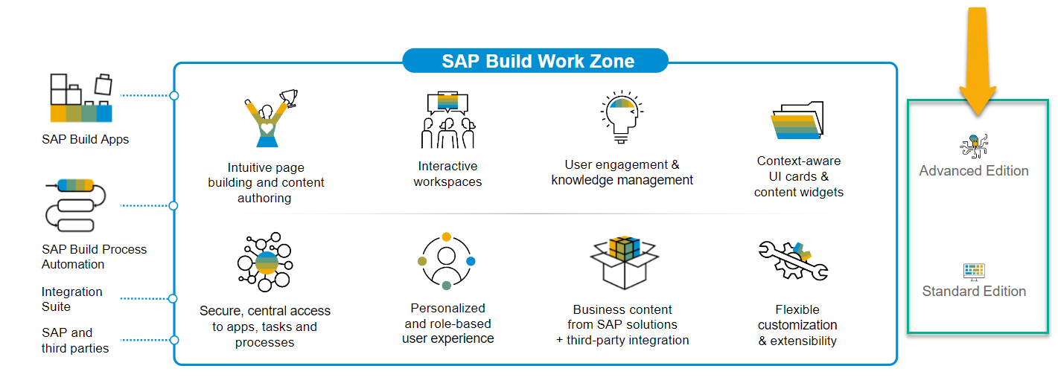
SAP Build Work Zone?
SAP Build Work Zone, advanced edition is a powerful SAP Business Technology Platform service that consists of several components
SAP Launchpad Services is now called SAP Build Work Zone, Standard SAP Work Zone is now called SAP Build Work Zone, Advanced

Slide 30
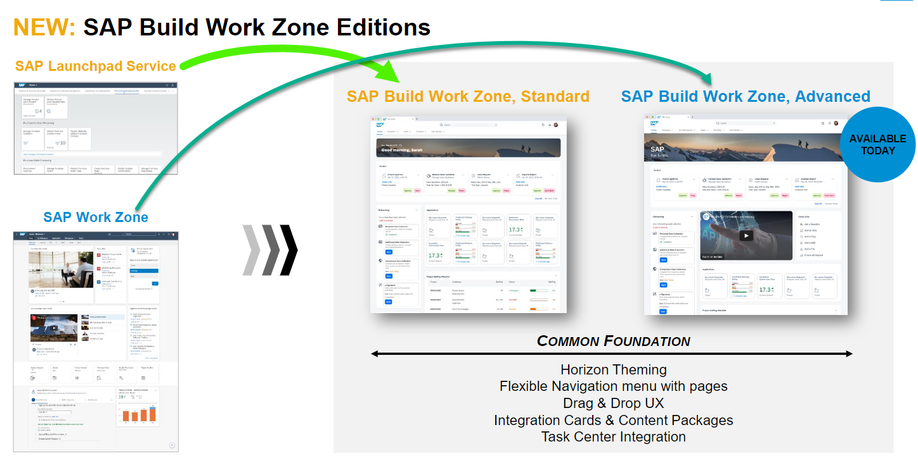
Offerings of Build Work Zone

Slide 31

Hands-on Setting up Build Work Zone

Slide 32
Chapter 3: SAP Build Process Automation
What is Business Process
What is Business Process management
Good v/s Bad Business Process
BPM Approach
Key Roles involved
What is SAP Build Process Automation offering
Hands-on Setting up SAP Build BPA in BTP Trial account
Different Working Models

Slide 33
What is Business process?
In big organizations the large number of employees can only be managed when we have pre-defined, standardized processes. Processes in each area like leave request/approval, SRM purchasing, Order-to-cash, order approval, maintenance contract preparation, procure-to-pay, hiring.
It is in the best benefit of a company to comply to business process is to automate the same.
Classical SAP world (On-premised) we have SAP Workflow to automate a business process.
To create a workflow we use tcode as SWDD.
In the modern world the business process is not just about writing some sequence of steps but also require high amount of automation to bring down manual efforts like checking invoice amount from a pdf document and matching with invoice value in SAP S/4HANA database table.

Slide 34
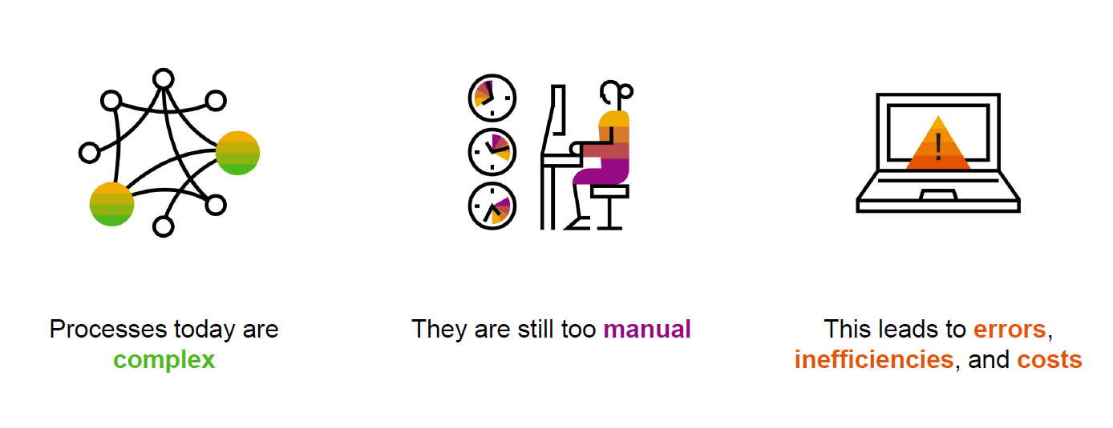
What is Business Process Management?
Business process is the heart of an ERP system and a software which manages such business processes is called BPM.
In a company running thousands of processes, it can be challenging for management to see where things are going wrong. In the end, it all comes down to how well business processes can be defined and executed.
Business Process Management Software helps you to bring structure into the large amount of your company’s business processes. It helps to prevent potential chaos and to clearly define and manage the processes.

Slide 35
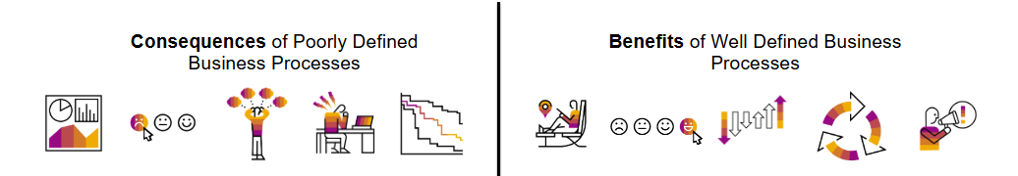
Good v/s Bad Business process
Well-run processes improve communication between people and departments. Accuracy, speed, and efficiency are big advantages. This can eliminate daily confusion or frustration and increase accountability within a team. Rather than blaming a process for delays or failures, team members can take on more responsibility and focus on their goals.
However, not all processes are good. Even if they’re not engineered well, bad processes can still be running in your organization. While these might still get the job done somehow, it is those processes that can cause the biggest issues – for you personally and overall.

Slide 36
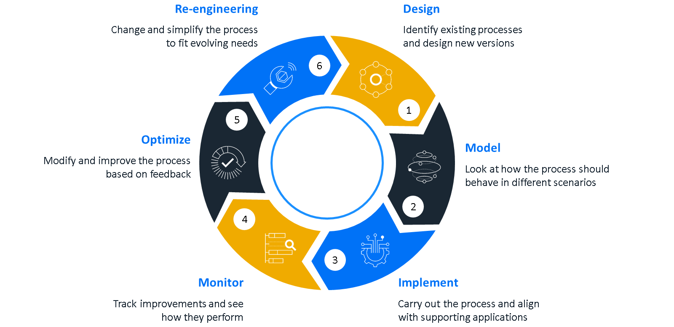
The BPM Approach
Business Process Management (BPM) is an approach used to identify, analyze, measure, and improve an organization’s processes. BPM is not to be seen as just another software in your company, but rather as a strive for operational excellence. It helps a company run faster, better, and at a lower expense, too.
This is achieved via the BPM lifecycle which consists of six stages that a company should undertake to strive for operational excellence.

Slide 37
Key roles involved in the Business Process
The key roles involved in a business process can be categorized into three different groups: Primary Participants, Secondary Participants, and Stakeholders. The following example - Roles involved in a Laptop Ordering Process - provides a simple overview.
Process Owner
Is overall, responsible for a process from the business perspective. Needs to trigger process adjustments when something does not run smoothly. E.g. the HR needs to define a smooth on-boarding of employee.
Process Initiator
Starts the process by performing an action. This can happen knowingly or unknowingly. E.g. employee who request for new laptop when he/she joins the company.
Decision Maker
Is responsible for taking decisions that influence the direction of the process. Approvals or rejections naturally lead to different process outcomes. E.g. manager who approve the new laptop request
Process Participants
Need to perform certain tasks within the process. These can be physical tasks or tasks performed within software systems. E.g. a IT executive who release the device to employee once request approved.
Process Instance Reviewer and Process Metrics Reviewer
Has a particular interest in certain process runs or the overall process metrics due to their job description.

Slide 38
SAP BTP Build Process Automation
SAP Build Process Automation is a citizen developer solution to adapt, improve, and innovate business processes with no-code workflow management and robotic process automation capabilities.
SAP Build Process Automation enables business users and technologists to become citizen developers. With powerful yet intuitive low-code and no-code capabilities, the solution supports you in driving automation by tapping into the expertise of citizen developers.
Features
Build or adapt processes with an intuitive graphical interface.
Create forms-based workflows using drag-and-drop functionality.
Develop and manage decision logic in tabular, spreadsheet-like decision tables.
Automate repetitive tasks within existing process flows using robotic process automation.
Create intelligent actions and recommendations using machine learning capabilities.
Work efficiently from a unified launchpad and task center.
Hand over projects to professional developers, who can embed actions and advanced workflows into projects initiated by citizen developers.
Support real-time, event-driven transparency into comprehensive processes and process instances with process visibility dashboards.
In addition, SAP Build Process Automation offers prebuilt content and features – such as bots, process steps, business rules, and workflow components.

Slide 39
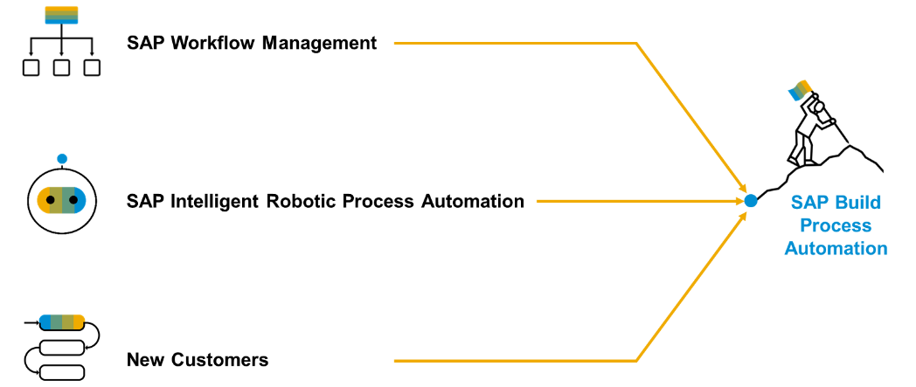
Product Overview
SAP Build Process Automation is a solution that evolved out of the former stand-alone SAP products - SAP Workflow Management and SAP Intelligent Robotic Process Automation. It provides a new citizen developer experience that didn't exist in either of the two former products.
As you or your company might have used SAP Workflow Management or SAP Intelligent Robotic Process Automation in the past, you are looking for a path into the joined solution. Fortunately, SAP Build Process Automation is fully compatible with all workflow and automation artifacts that you have created.

Slide 40

Hands-on Setup and overview of BPA

Slide 41
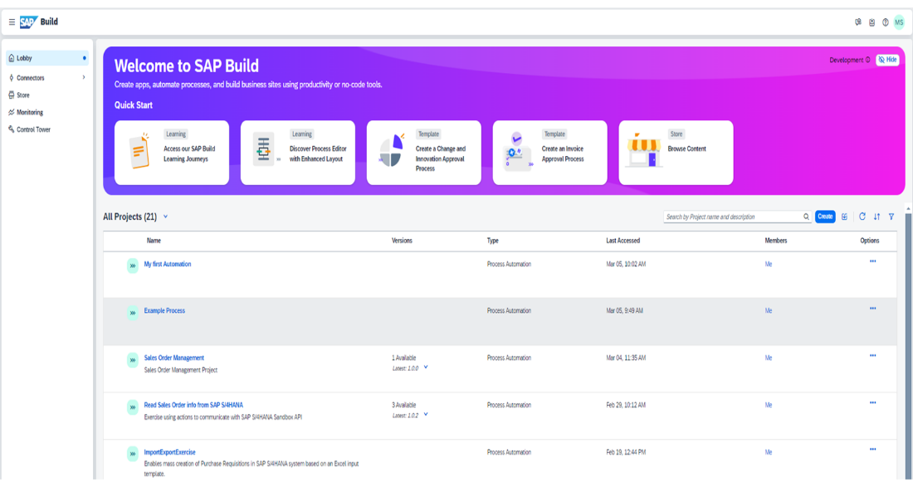
Core Components
Lobby – Centrally view and manage all build apps and business processes.
Process Builder- a LCNC design studio to design the business process and add multiple tasks
Connectors – configure connections with the systems
Store – Explore and import pre-built SAP standard process content
Monitoring – Analyze and monitor the on-going processes
Control Tower – Discover the implementation guide and configure IRPA desktop agents

Slide 42
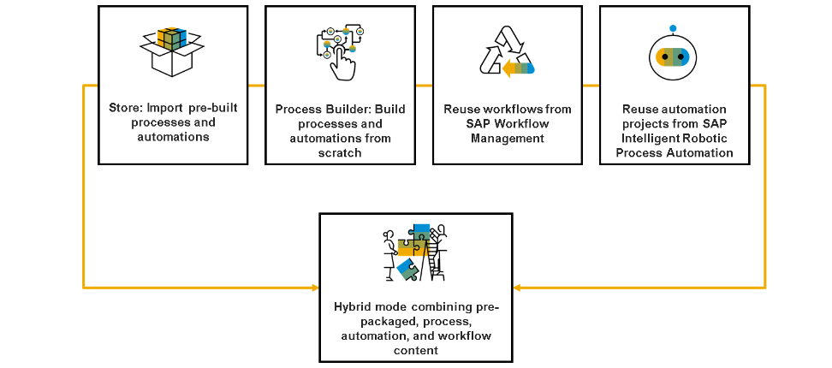
Different working models
As a person that wants to create process in SAP Build Process Automation, you can choose from a set of different working modes:
Import prebuilt processes and automations from the built-in Store.
Build custom processes and automations from scratch using the Process Builder tool.
Reuse workflows from SAP Workflow Management – either as a migration effort or when SAP Build Process Automation capabilities don't fulfill all your needs.
Reuse automation projects from SAP Intelligent Robotic Process Automation – existing SAP Intelligent Robotic Process Automation Cloud Studio projects are fully compatible with SAP Build Process Automation.
"Hybrid" mode combining pre-packaged process and workflow content.

Slide 43





Slide 44
Chapter 4: SAP Build Process Automation
Configure SMTP destination to send email from SAP Build
Create backing service for build process automation

Slide 45
Configuring the SMTP mail destination
We will create a process with many process steps including the actions, mail steps. A mail step is executed is executed to send a email. E.g. when a manage approve leave request of an employee, the employee receives an email.
SAP build process automation
Destination
sap_processautomation_mail
Smtp.sap.corp
Mail server

Slide 46
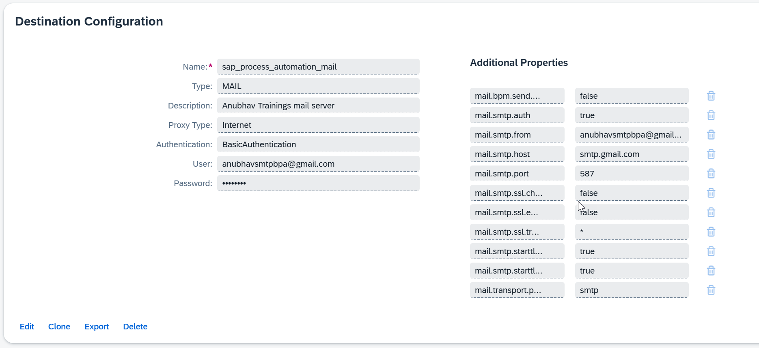
Process to configure gmail
Make sure that 2FA is enabled for your google account (documentation link)
Open the link https://myaccount.google.com/apppasswords
Generate an app password - zlqd qyuf kcpt jujm
Maintain destination using documentation here
The destination name must be - sap_process_automation_mail

Slide 47

SAP build BPA
Design time – create a process
(citizen developer)
Sap build process automation service instance
deploy
BTP platform
Running version process
(deployed in cloud) – Runtime
Datacenter.subac.project.process
API trigger business process

Slide 48
Chapter 5: Design and Deploy First process
What is an API?
SAP Business API HUB
Explore SAP sales order API
Explore process builder
Create Data types
Create Input and Output variables
Define trigger conditions
Adding Approval steps
Configure send Email with Rejection step

Slide 49








What is API?
API stands for application programming interface, it is a contract between our system and a system which is trying to connect with us.
API gives a contract between caller and called party
That makes integration possible w/o knowing internal functionality of system
Critical role in integration and exchange of data between systems
Servers as single entry point for different business objects (so,po,material)

Slide 50
API HUB
SAP provides a publicly available website. Any developer can go and explore the APIs offered by SAP Solutions e.g. S/4HANA, BTP, Success Factors, Field Glass, Concur etc.
https://api.sap.com
You can request S/4HANA server access – server@anubhavtrainings.com

Slide 51


Scenario
Build Process Automation
BTP
Sales Order
approval
<data>
form
mail
Manager
<data>
Sales Representative
(fedEx office)
Build workzone
My Inbox
S/4HANA

Slide 52
Data types
Data types are the skeleton of the data. They will comply usually with APIs of S/4HANA. So that when we trigger our build process automation e.g. from S/4HANA, the data can be passed easily.
What is a work item
When we execute a step, at runtime the user/approver will receive a notification, that is due to the runtime instance of a step which was executed in process. The runtime instance of a step of the process is called work item. This will be received typically in a standard app in BTP work zone called My Inbox app.
Context
A context is the data which is circulated and available in our business process throughout the execution of the process. This data will be based on the data type we create and connect to api trigger. Usually this is available in JSON (Java Script Object Notation).

Slide 53
JSON
{
key: ‘value’,
key: ‘value’,
key: ‘value’
}
orderNo shipTo date
101 | SHIP1 | 20251212

Slide 54
Chapter 6: Deploy and Configure Work Zone
How to deploy the released version of process to BTP
Understanding My Inbox App
Configure the destination sap_process_automation_service
Import the Standard BPA apps to Build Work zone
Install POSTMAN tool

Slide 55
Deploy the BPA process
Design time object
process
Runtime object
process
deploy
We can check the control tower > environment,> process > triggers when open the same we can find the API and the context.

Slide 56
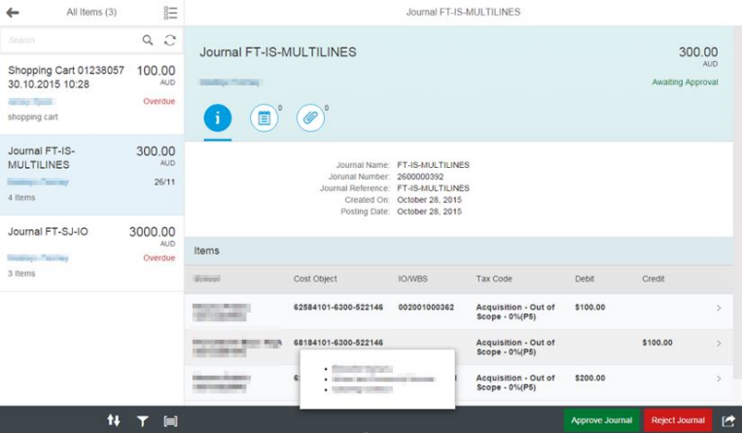
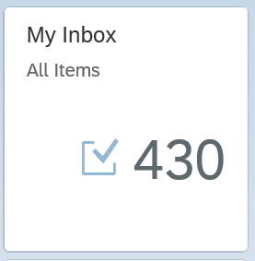
My Inbox Fiori App
In SAP Business Technology Platform (BTP), the Inbox Fiori app typically refers to an application that provides a centralized view for managing tasks and notifications within the system. This app allows users to handle workflow tasks and process approvals directly from within the Fiori interface.
Here are some key points about the Inbox Fiori app:
1. Task Management: It provides an interface where users can view, manage, and act upon their tasks. These tasks can be related to business workflows, approvals, or notifications that need attention.
2. Integration with SAP Workflow: The Inbox app is often integrated with SAP Business Workflow, allowing users to interact with tasks that are part of larger business processes.
3. User-Friendly Interface: As part of the Fiori design principles, the app offers a simple, intuitive, and responsive user interface that can be accessed on desktop and mobile devices.
4. Real-Time Updates: Users are notified of new tasks, and updates to tasks are reflected in real-time, ensuring that users can stay on top of their workload.
6. Access Control: Only users with appropriate roles and permissions can access specific tasks, ensuring that the right people are notified and able to act on the tasks.

Slide 57









The destination sap_process_automation_service
https://help.sap.com/docs/build-process-automation/sap-build-process-automation/configure-sap-build-process-automation-destinations

Slide 58

The Postman tool
Postman is a popular API (Application Programming Interface) testing and development tool. It provides an easy-to-use interface for interacting with APIs, enabling developers, testers, and other users to test, debug, and document APIs efficiently. It is widely used in the software development lifecycle to ensure that APIs function as intended.
Send requests (GET, POST, PUT, DELETE, etc.) to APIs and receive responses.
Validate the API’s behavior, response codes, and data.
Simplifies sending HTTP requests without needing to write complex scripts.
Supports various authentication methods like OAuth, Basic Auth, Bearer Token, etc.
Reduces manual effort by automating repetitive tasks.
Helps in documenting APIs for better team understanding.
Integrates well into agile and DevOps workflows.
It is available as a desktop application, web application, and browser extension, making it accessible across different platforms.
https://www.postman.com/downloads/

Slide 59
Chapter 7: Trigger the Business Process
Configure postman tool
Explore the BPA APIs
Extract the JWT token from the BTP XSUAA
Use the token to trigger the API

Slide 60
APIs on API HUB
https://api.sap.com/api/SAP_CP_Workflow_CF/resource/Workflow_Instances

Slide 61













SAP BTP CF Security Concept

Slide 62
Chapter 8: Monitoring & Enhancement
Adding control and events
Using decision table for dynamic approver determination
Monitoring Business process (debugging and troubleshooting)

Slide 63
Control
Start
Start
Check if the condition

Slide 64
Requirement
If the sales order amount < 500 EUR – There is no approval required, a direct email will be sent to process initiator that order was auto approved.
Decision Table
When we need to determine multiple conditions, then we can opt for decision table. A control will create branch(s) in the business process but a decision table is a step itself. The control will be used to trigger multiple steps and manage the flow of process at runtime but the decision table is predominantly used to determine the context data at runtime.
e.g. If the sales order type is OR – Standard Order – approval should go to Anubhav – Anubhav.abap@gmail.com
If the order type is IN – inquiry – approval should go to Vaishali – Vaishali@evotrainingsolutions.com
Example of dynamic agent determination like we do in classic abap workflow.

Slide 65
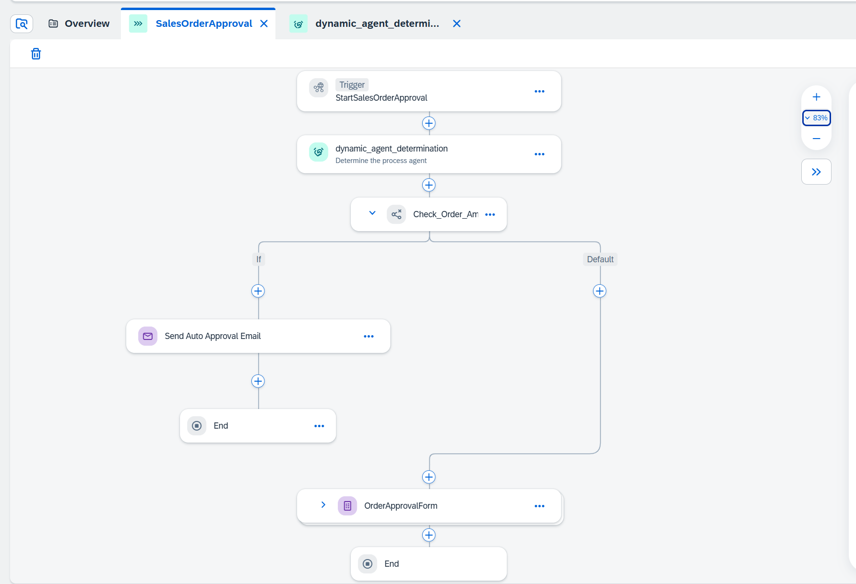

Slide 66
Chapter 9: Calling APIs and Script Tasks
[Update] ticket on Build work zone issue
Open Questions?
What is environment in BPA?
Calling external APIs from Build Process
Create and manage actions in Build process
Configure the destination to call API
Adding Script tasks
Working with parallel processing
Deadline monitoring

Slide 67
Questions?
What is the environment in Build BPA?
How to check all the available BPA deployed versions ?
How to delete a BPA process?
How to export and share the BPA project with other colleagues / production system?
Where is the SAP Build product documentation
https://help.sap.com/docs/PROCESS_AUTOMATION?locale=en-US&state=PRODUCTION&version=Cloud

Slide 68
What is Environment in Build Process Automation
An environment is a functional area in which you deploy and run your SAP Build Process Automation projects.
You use an environment to control how you deploy and execute projects. A project can be deployed in more than one environment and for different project versions. By creating shared environments, you can increase the security of deployed projects and the corresponding artifacts and resources, by limiting access and managing project members.
You can use two types of environments:
Shared: A shared environment is created by users with the ProcessAutomationAdmin role and can be shared to users with the ProcessAutomationDeveloper role. By creating more than one shared environment on your SAP Build Process Automation tenant, you can isolate the deployment of different projects or project versions.
Public: The public environment contains all of the existing projects already deployed in SAP Build Process Automation. The settings in the environment correspond to the settings already made for these projects. Access to the public environment is protected at the tenant level so every user who has access to the tenant has access to the public environment.
Each environment contains distinct configurations that define the conditions for the running projects. These include: Projects, Automation Launchers, Triggers, Agent Management, Alert Handlers, Variables, API Keys, Visibility Scenarios, Processes and Workflows

Slide 69

Build Process Scenario 2 – Script Task
Alex is a manager working in one of the top IT Company. He is being approached for every shopping cart request created by employees reporting to him.
His key requirements are:
Design a process to automate the shopping cart for products available at the global API of our organization
As part of the input user can request a discount % to each of the product
The approval should be sent parallelly to VP and manager with a table showing products and total value with discount
Once both the manager and VP approves the requests, an approval email will be sent to requestor
If VP do not take action on shopping cart request for more than 5 minutes, we should proceed w/o approval

Slide 70
The Service
The service information is here:
https://services.odata.org/northwind/northwind.svc/
Property | Value
sap.applicationdevelopment.actions.enabled | true
sap.processautomation.enabled | true
sap.build.usage | odata_gen

Slide 71
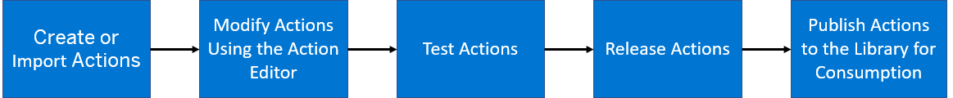
Actions in BPA
You can embed external skills and capabilities into your SAP Build Process Automation projects using the Actions . The Actions project contains specific action artifacts that can be used in managing your business processes.
An Overview of the Actions Project Lifecycle
This image is interactive. Hover over each area for a description. Click highlighted areas for more information.

Slide 72
Steps
Create a destination for the API (service) we want to call
Create an action using the destination and choose a call for getting products
Observe the output and data types if match with result
Go to control tower and destinations and import that destination build BPA
Go to test and check the action by calling API, if needed change data type to fix error
Once testing done, save, release and publish the action
-------
Create a process
Define the input parameter and create api trigger
Add a action connecting to API action for products and system creates a list data type for us
Use the datatype to create variable for holding all data, total, discountedAmount
Map the input and output with action, input process and custom variable
Add script task to calculate total and discount amount
Add parallel branch to execute approval step for manager and VP (binding)
Create deadline monitoring for VP approval form

Slide 73
//get all the data in a variable
var products = $.context.action_get_Alphabetical_list_of_products_1.result.value;
//set default as 0 for total
$.context.custom.totalamount = 0;
///loop on all products data
products.forEach(function (record) {
$.context.custom.totalamount += Number(record.UnitPrice);
});
var discount = $.context.custom.totalamount * ($.context.startEvent.discount) / 100;
$.context.custom.discountedamount = $.context.custom.totalamount - discount;

Slide 74
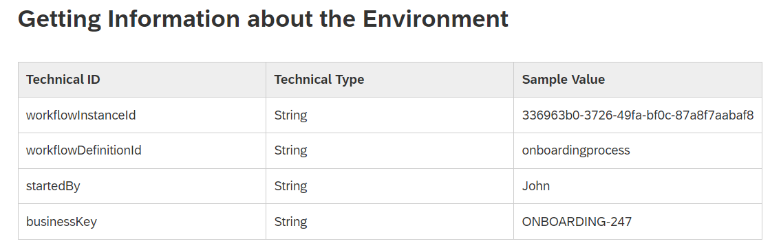
Script task
Script task – we can write code to manipulate the process context, call the process apis at runtime (JS code)
We can also modify the context data during runtime of script task using - $.context.objectname
There are also standard context variable
Cheat sheet workflow expressions
https://help.sap.com/docs/WORKFLOW/e157c391253b4ecd93647bf232d18a83/9f91b1c0fac3414d9cba1015dea381f1.html

Slide 75
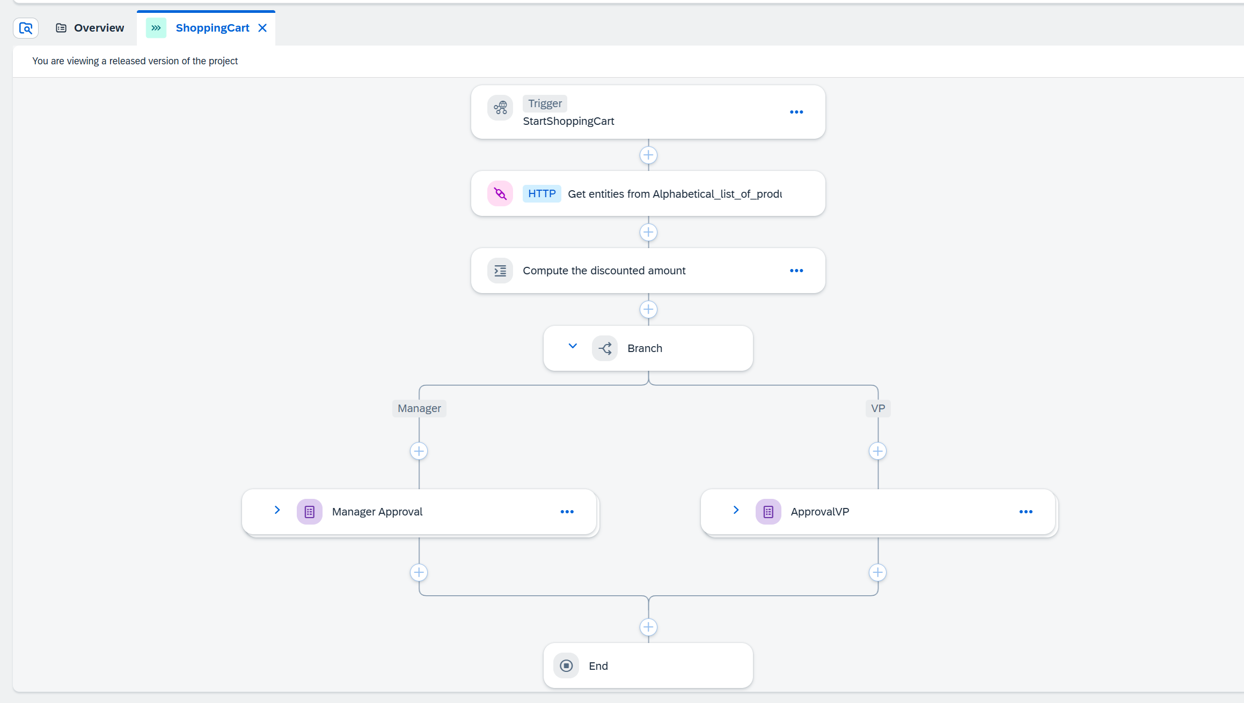

Slide 76
Chapter 10: Working with Sub Process and Automations
Open Questions?
Create a new project
Adding a sub process
Create main process with list data type
Retrieve associated data from APIs using action
Installing the RAP agent
RPA agent configuration
Adding Automation

Slide 77
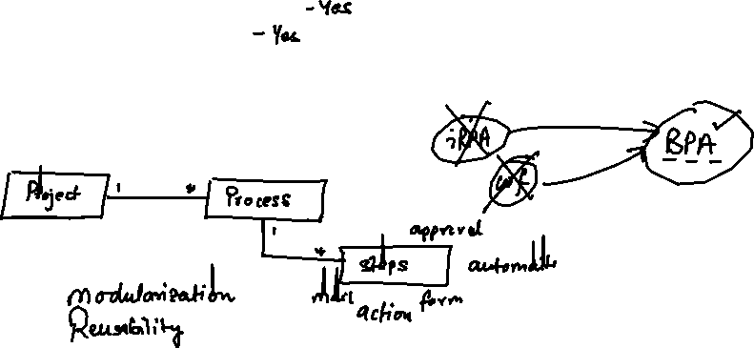
Questions?
Can we add multiple process in a single project?
Is it possible to make a process reusable.
What is IRPA and how it relates to SAP Build process automation.
Do we have an example of working with list data type.

Slide 78
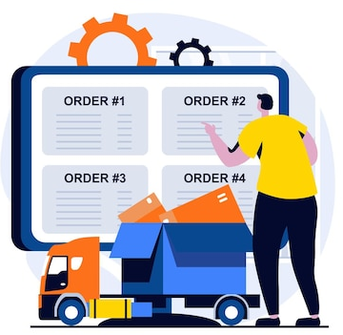
Scenario – Mass order management
We are working in a warehouse, where we receive bulk orders for multiple customer. Till now our company was dispatching orders to each customer one by one, how there is a need to process all the customer orders in bulk (mass order management).
We already have a business process to manage single order of a customer and trigger the email to respective customer, our goal is to design a new process where the current process be added inside a loop as a sub process and call it multiple time for each order of same customer.

Slide 79


















Slide 80
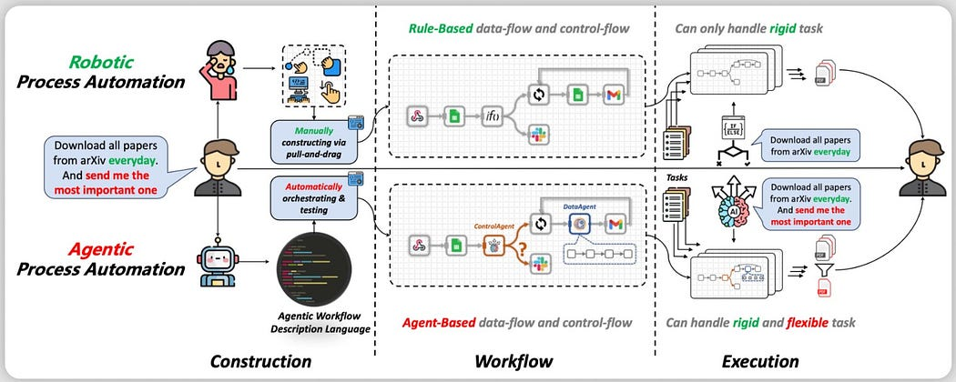
iRPA
Robotic Process Automation (RPA) has been used to automate mundane and complicated business processes. RPA uses software robots to automate the boring stuff done by humans such as data entry, transaction processing, web scrapping and so forth.

Slide 81
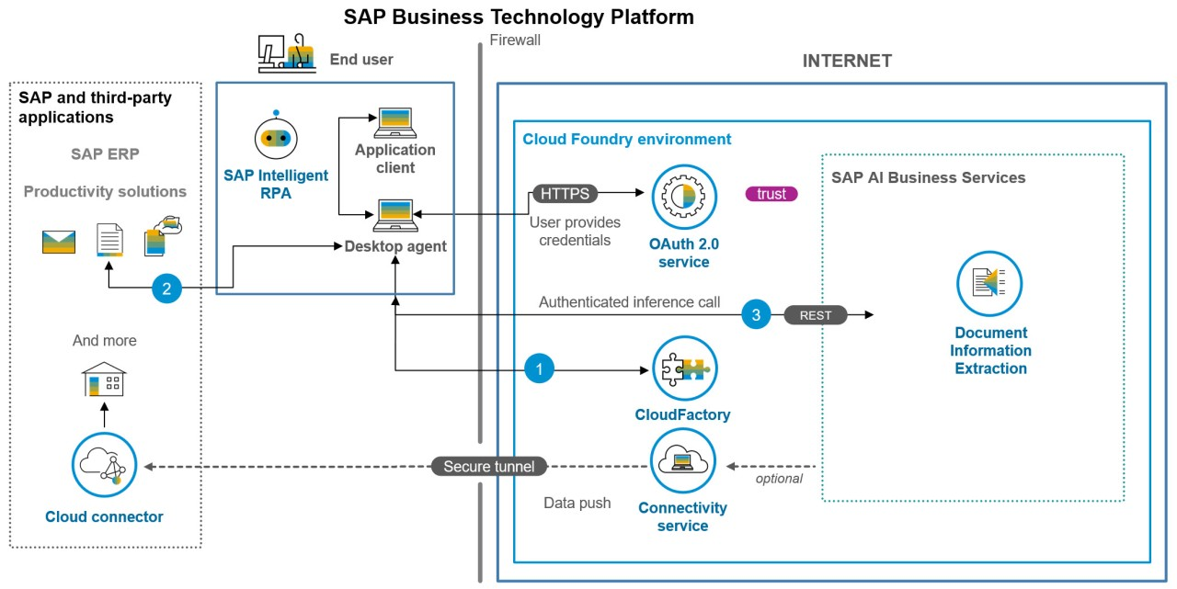
The Design

Slide 82
What is iRPA Desktop agent?
The Desktop Agent is a component of SAP Build Process Automation that is installed locally on user desktops. It executes automation projects that launch and run applications of various kinds, reads information from screens, enters data, clicks options, and processes data.
Projects are assigned to tenants running on a Desktop Agent. You can see what your Desktop Agent is doing at all times thanks to the convenient system tray, or Systray, that is always accessible while your Desktop Agent is ready or active.
When it is installed, the Desktop Agent is configured to start at Windows logon automatically. You should not change this setting because your Agent might be assigned background (unattended) jobs at any time.
The very first time you launch the Desktop Agent on your workstation, you will be prompted to log in. If you are unsure of your login details, please ask an administrator.

Slide 83
Steps to configure Desktop agent
Download the Desktop agent (RPA agent) 3.0 – https://tools.hana.ondemand.com/#cloud
Added the agent to control tower settings
Register the agent in the environment
Set the mode as unattended mode
Enable the browser plugin with allowed settings in chrome
Guide for desktop agent 3
https://help.sap.com/doc/dd104fba73bd4ac19abf88080ff88512/Cloud/en-US/1d297d6d159346dcb94928b90c019b9e.pdf
If you plan to use productive Desktop agent, follow the guide below (permission for SAP software downloads)
https://developers.sap.com/tutorials/spa-setup-desktop-3-0-agent..html

Slide 84
Chapter 11: Part 1 Custom UI5 Task in Business Process
Custom Task UI - the concept
Hiring Scenario with Custom Task UI
What is SAP UI5?
What is Business Application Studio
What is Dev space
How to start SAP UI5 development to Task UI
Create MTAR project
Enhance project with data context
Calling standard APIs to complete tasks
Build and Deploy the mta project
Understanding HTML5 Repo, App Router, Destination, XSUAA
Integrate custom UI with Build BPA

Slide 85
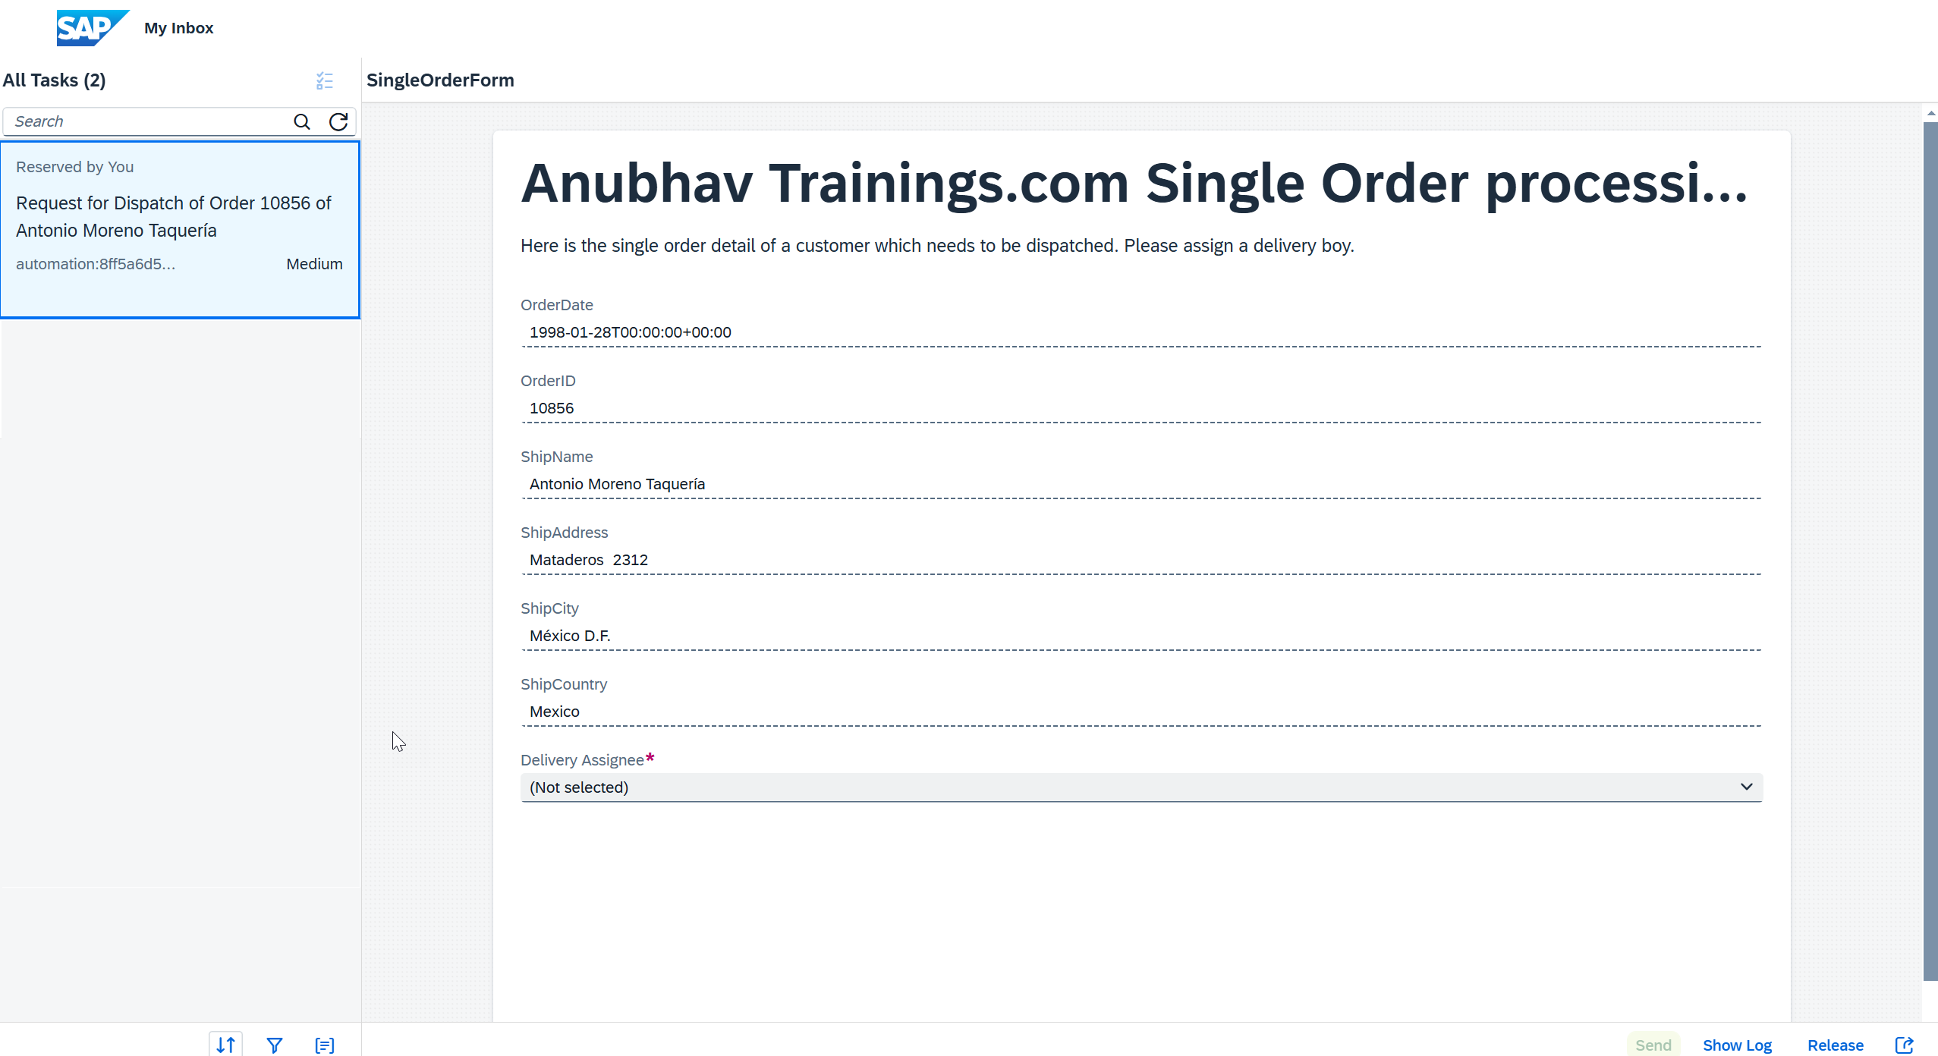








Custom Task UI
So when we don’t want to use the Approval form, normal form in SAP Build BPA, instead of that we want to use a completely custom UI. In this case, we opt for custom task UI. This is hardly 5-8% scenario because most scenarios are covered with standard approval/task forms.

Slide 86

Employee Hiring Scenario – Custom UI task
Sofia is working as a lead manager in one of the outsourcing company. She help IT companies to find right talent and send them to offshore project. She want us to design a business process, which when started request for following candidate details
Name, Work Experience (number), Previous/Current Employer name, Skills (ABAP, UI5, BTP, S/4HANA), Country for travel, and budget (in USD)
Once the details are filled, a work item needs to be sent to HR specialist to review details and approve/reject the budget.

Slide 87

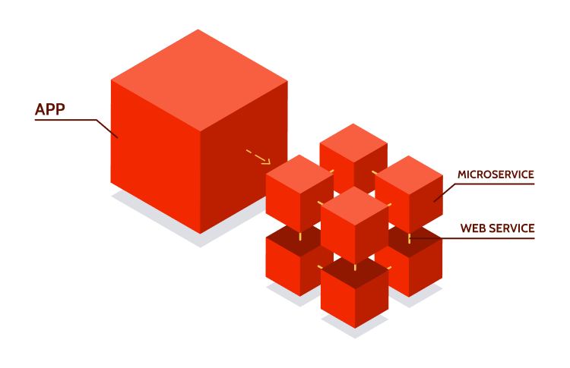
What is SAP UI5
What is SAP UI5
SAP UI5 is a framework to develop responsive web applications which can run on any device, any platform and any
browser. It is SAP’s latest UI technology to build Fiori (user experience) applications.
We can develop an SAP UI5 project with Business application studio. The main aspects are
Component.js – a starting file for launching and initializing our app
View – the application user interface to display controls to the user – coded in XML
Controller – Where we write all processing logic
Model – the data related to the application
Join us on end to end ui5 development course at Anubhav Trainings
What is Microservice Architecture
When we use SAP BTP Cloud foundry environment, all the deployed applications are realized as microservices. For example, if we create a workflow, it is one microservice at runtime. Similarly a SAP UI5 application is also created as a microservice. These micro-services consumes backing services of cloud foundry environment to run.

Slide 88
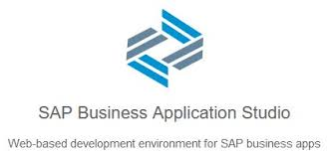




What is Business Application Studio
BAS stands for Business Application Studio, it is a multi-cloud development tool provided by SAP which runs on SAP BTP (Business Technology Platform).
On the trial account “go to trial account”, choose instances and subscriptions, and launch the business application studio
We must create a dev space which has following functions:
It will restrict the amount of memory which is used by single developer
It is your private area where you do development
It comes with all the tools pre-installed for our specific kind of development, Fiori – nodejs, git, ui5 tooling..
Launch the dev space and open folder as projects folder so we can organize everything
Create project and files.
If you use productive BTP account with BAS tool there is a cost -

Slide 89
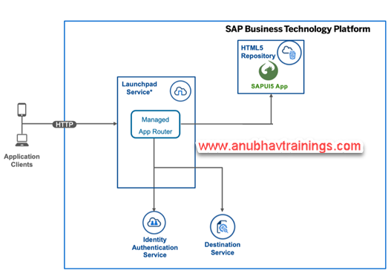
Core Concepts of Building UI on BTP
Managed App Router
The managed application router enables you to access and run HTML5 applications in a cloud environment without the need to maintain your own runtime infrastructure.
The managed application router is the HTML5 applications runtime capability
SAP Launchpad service
To use the managed application router, you must be subscribed to one of these services.
HTML5 application repository enables central storage of HTML5 applications' static content on the SAP BTP, Cloud Foundry environment. This service can be consumed from the SAP BTP, Cloud Foundry Runtime. HTML5 applications consist of static content such as HTML, CSS, JavaScript, and other files, that run on a browser. HTML5 application repository allows application developers to manage the lifecycle of their HTML5 applications. In runtime, the repository enables the consuming application, typically the application router, to access HTML5 application static content in a secure and efficient manner.

Slide 90
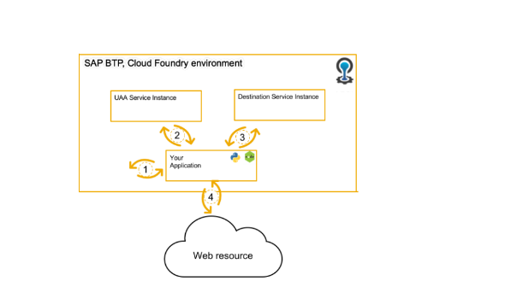
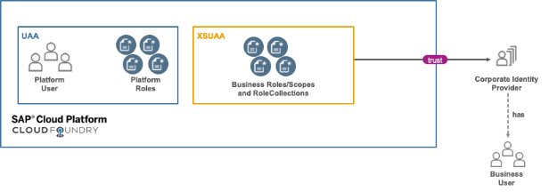
More BTP Backing Services
Destination Service
Destination service REST API specification for the SAP Cloud Foundry environment.
The Destination service provides a REST API that you can use to read and manage destinations and certificates on all available levels.
The service is helpful for
Never ever (ever!) add sensitive information, such as passwords, to your code!
Authentication strategies vary access different destinations types and you need to implement each single one
Dev tools (like code generators) have virtually no use if they cannot access supporting information
XSUAA Service
The XSUAA is one of the most important component to deal with when developing your own applications on Cloud Foundry. It takes care to authenticate and authorize your business users and assign the right principals to your user’s session so your application can:
Identity the user by Email, UserId, First and Lastname
Check his roles (scopes) to decide if a user is allowed to do something or prohibit is action

Slide 91
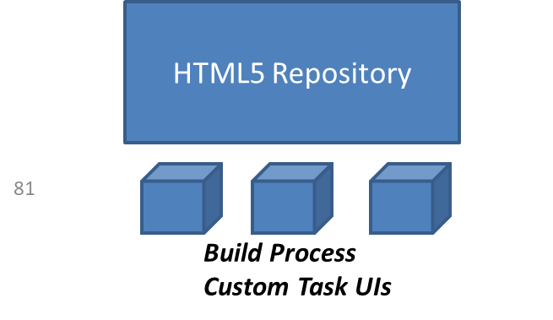




Managed App Router
As mentioned before, the managed app router will be responsible to communicate between our UI5 module and our BPA runtime API. Since the app router also usage the XSUAA service, it will only allow authenticated calls to direct to our application.
Managed App Router (usage xs-app.json)
BPA Runtime APIs in BTP

Slide 92
Steps
Create BAS tool dev space with workflow module
Open projects folder in BAS
Create project from template > New Multi Target Module
Right click on MTA.yaml file and choose add module from template > App router confirguation
Right click on MTA.yaml file and choose Workflow UI > Task UI
Replace the View Content as explained
Change flexEnabled: false in manifest
Add the memory context to the manifest.json file at the end
Change the root view setting to load Main view
Open the Main.controller and add implementation to set data to context for selected skills in dropdown
Open Component.js and find method _patchTaskInstance and add the decision code to be sent
Right click on mta.yaml file and choose build mtar
A mta_archieve folder gets created, in which we find mtar file which we right click and deploy to BTP
You can check the app under the HTML5 Repository under sub-account.

Slide 93
The MTA file
Once we finished adding task UI component, a new UI5 module gets added along with configuration in mta.yaml file. The MTA.yaml file below explains the purpose of each component and backing services added to the multi target application.

Slide 94
Chapter 12: Part 2 Custom UI5 Task in Business Process
Question: How to import the UI project in BAS tool
Integrate custom UI with Build BPA
Task Model in the app
Behind the scenes

Slide 95
Employee Hiring Scenario – Custom UI task
Sofia is working as a lead manager in one of the outsourcing company. She help IT companies to find right talent and send them to offshore project. She want us to design a business process, which when started request for following candidate details
Name, Work Experience (number), Previous/Current Employer name, Skills (ABAP, UI5, BTP, S/4HANA), Country for travel, and budget (in USD)
Once the details are filled, a work item needs to be sent to HR specialist to review details and approve/reject the budget.

Slide 96


Slide 97
Task Model
My Inbox passes the additional data to a custom task UI through the SAPUI5 component’s startup parameters.
The task model contains data related to user tasks.
The taskModel is of type sap.ui.model.json.JSONModel and contains the following task properties:
https://help.sap.com/docs/WORKFLOW/e157c391253b4ecd93647bf232d18a83/735e9ff312dc4b8c838093a1e245518f.html?q=getInboxAPI
You can add task completion buttons to My Inbox, control the visibility of the footer bar or the back navigation button, and more with the My Inbox UI Integration API.

Slide 98

Behind the scenes

Slide 99

Recap
Building the Task UI App
Deploying Task UI App
Checking deployed App
Configuring the form in Process
Building the end-to-end process
Deploying the process
Testing the process

Slide 100
Chapter 13: Working with Start UI
What is start UI
How to create and configure Start UI
Deploy Start UI
Adding Start Fiori UI to Build Work zone

Slide 101




















Slide 102
What is Start UI
A user interface is needed which would allow end users to start the instances of the corresponding workflow. In addition, the users must be able to specify some arbitrary values that will be used in the contexts of the started instances.
You can either define the start UI using an HTML5 application (custom start UI).
"crossNavigation": {
"inbounds": {
"myworkflowapps": {
"semanticObject": "app",
"action": "open",
"title": "My Title",
"subTitle": "My Subtitle"
}
}
}

Slide 103
Steps to create Start UI
Start the BAS tool, click berger icon and choose help>Get started
Start project from template > Create MTA application
Right Click on mta.yaml file and choose add mta module and add the app router configuration
Right click on mta.yaml file and choose add mta module and select workflow UI
Enter the project name, select template as start ui
Add the Main view code which has the fields to start the build process and a button
Open manifest.json and make flexEnabled = false, Change the rootView to main
Add the crossNavigation component in sap.app section with your app title, this info will be used by Build workzone to give unique title to our application
In the xs-app.json we provide a link to connect to destination “sap_process_automation_service” that will provide the end point to start the build process (same link which we gave in postman)
Next we replace all the existing controller functions with Anubhav’s controller functions, adapt the _startInstance function with our process id and context information
Open the ui5.yaml file and add backend configuration, only needed if you want to test your app in BAS tool first before deploying to BTP. This configuration will send a call to backend.
Install 2 modules for simulation(testing) – npm install -g @ui5/cli & npm install -g @sap/ux-ui5-tooling
Open myfioriapp>package.json file and change the devDependencies to "@ui5/cli": "^3.0.0", cd myfioriapp & run npm install
Test command – ui5 serve
We do local testing by checking console (F12) for error, and network tab for the call its making, final check the process instance.
Add the backing service of bpa runtime to the resources section of mta.yaml, build mtar and deploy mta_archieve to btp click here
Configure the app in SAP Build workzone

Slide 104
Chapter 14: Automating PDF Extraction
Understanding PDF invoice extraction Scenario
Add a decision and create data type
Create Decision table
Maintenance input and output of the decision
Create Automation
Create data types
Create input and output parameters
Create document template
Annotate and activate the document template
Build an automation
Passing parameters and mapping parameters with automation
Testing automation
Integrating with business process
Testing final process

Slide 105

The Scenario – Invoice Approval
Sonia is working at Anubhav Trainings finance department; every we create and send invoices to the customer. Her job is to check the invoices, especially the amount and module name for each invoice and validate if the payment has been received in the bank account.
Currently she has to open every invoice manually and read the invoice amount, date and course name and validate the date & amount submitted by internal sales team.
She want us to automate this process where the sales team share the invoice details along with date and we need to send approval form only when date match with pdf invoice to Sonia. She reviews the details and provide invoice approval.
On approved an email will trigger to student that their payment has been received for the course.

Slide 106

















Flow

Slide 107
Document template
The template will define the skeleton of the pdf document which helps RPA component (bot) to understand where which field of data is present. So, at runtime the bot can extract the exact data for us from pixel position of the pdf document.

Slide 108
Chapter 15: Excel Automation using Build RPA
Understanding Excel SDK for Automation
Create Excel link
Process Excel data
Create the automation
Create environment variable
Add Excel activities
Add input and output parameters
Create a variable
Looping through Excel sheet and searching for the order
Link automation parameters with business process
Test the automation
Simplify the start form
Update Process Condition
Mapping forms of the process

Slide 109
Understanding Excel SDK
The Excel SDK is a collection of activities allowing you to create automations using Microsoft Excel. It comes with a rich set of functionalities such as:
Create new Excel Workbook
Create new Excel Worksheet
Read and write data from an Excel sheet, for a given data range
Apply Filter on a column etc
To design your automation, you will need an Excel file filled with the sales orders data.
What is Excel Data Mapping?
Excel Data Mapping allows you to transform columns-based data from an Excel sheet into datatype that can be used in your automation. The data from the Excel sheet stays the same but the structure becomes a data type structure, making it possible to use throughout your project.

Slide 110


Scenario
Ran is working in the service department of the company; his routine job is to
read all the sales orders from an excel file he receives,
filter all the orders which are at urgent status
send an email to corresponding customer on order delivery date
In addition, filter orders with amount > 1000000 and create a new sheet in excel as Results
Keep the excel in his system

Slide 111


Automation Flow design by Anubhav

Slide 112
Chapter 16: Automation for MS outlook Mails
Understanding Outlook SDK for automation
Adding outlook sdk to settings
Opening outlook instance
Reading email counts
Writing infinite loop to read all emails one by one
Writing exit condition for email loop
Reading email subject and email id
Retrieve the attachments from the email
Download attachments to our local machine

Slide 113
Outlook SDK
The Outlook SDK in SAP Build Process Automation, is a collection of activities allowing you to create automations using Microsoft Outlook. It comes with a rich set of functionality. For example:
Search an email
Read an email
Download attachments from an email to your local folder
Reply to an email
Administrative operations like move or copy email from one outlook folder to another and many more

Slide 114

Scenario – Download All mail attachments
Melania is working in the HR department of the company; her job is to download all the profiles which are received over the inbox in her local computer.
For this work, she has to open the inbox every morning, open each email one by one and download the attachments. We would like to automate the process for her.

Slide 115
Chapter 17: Automation of Fiori App
Why we need to automate Fiori application
Basics - DOM
Scenario – Manage Order Fiori App
Understanding Screen capture tool
Working with DOM elements
Extraction of UI elements from UI5 screen and create elements
Working with Repeated elements in DOM
Setting the data to excel for extracted order

Slide 116
Why we need UI Automation?
Fiori UI automation for data extraction is useful when users do not have technical knowledge on APIs and also want to make sure that the screens of the applications are stable and offering consistent user experience release-on-release. Here are some other benefits of UI application automation
1. Extracting Data from Dynamic Web Pages
Websites often load data dynamically using JavaScript, making it difficult to extract using traditional scraping techniques.
UI automation can interact with the page, scroll, click, and extract real-time data.
3. Automating Repetitive Manual Work
If users frequently copy-paste data from an application’s UI, automation can speed up the process and reduce human errors.
4. Interacting with GUI-Based Applications
Some applications (e.g., SAP GUI, Windows desktop applications) do not expose data via APIs but display it in tables and reports.
UI automation tools (like SAP GUI scripting, Selenium, or RPA tools) can extract this data efficiently.
6. Ensuring Data Consistency
Automating data extraction ensures consistency in data collection, preventing human errors and discrepancies.

Slide 117
What is DOM
The DOM (Document Object Model) of a web page is a structured representation of the HTML content, allowing scripts (like JavaScript) to dynamically access, modify, and manipulate the elements of a webpage.
Tree Structure
The DOM represents the web page as a tree-like structure where elements (HTML tags) are nodes.
The root node is <html>, which has two main child nodes: <head> and <body>.
Hierarchy of Nodes
Each HTML element (like <div>, <p>, <a>, etc.) becomes a node in the DOM.
Nodes can have parent, child, and sibling relationships.
Dynamic Content Manipulation
Using JavaScript, you can modify the DOM in real time (e.g., change text, style, add/remove elements).
Example: document.getElementById("myElement").innerText = "New Text";
Why is the DOM Important?
UI automation (e.g., Selenium interacts with the DOM to extract data).
Essential for dynamic web development (React, Angular, Vue modify the DOM efficiently).
Powers browser-based automation and scraping.
Would you like to see a practical example of how to extract data from the DOM using JavaScript? 🚀

Slide 118
Scenario Sales Order App UI Automation
Neha is working as a sales representative in the sales department. She would like to prepare an excel of all the sales data present in SAP Fiori Application.
The Sales order Fiori app contains the order header and order item details along with customer data.
She open a sales order, manually copies the data from the app and fills it in excel template, once done she store the excel in her system for future reference. This is an error prone and laborious task, We want to use SAP Build to help her automating the same.
Here is the Sales Order Manage App

Slide 119
Chapter 18: Automation of SAP GUI
Guideline for screen automation
What is Recorder?
Classic SAP GUI – Sales order management
Record SAP GUI transaction with recorder tool
Save the recording in SAP Build
Test the GUI automation
Configure Environment variable
Load data from excel for materials
Edit the step to manage loop
Pass dynamic data for materials
Test the automation

Slide 120
Guideline for UI Automation
Whenever the DOM is changed in the provider application, you must capture it by clicking the Capture button in the recording widget.
For Example,
Opening of a pop-up, expansion of a tree, selection of a tab, and opening a new window.
If you missed a capture during the recording, you must fix it after the export:
Add the missing captures.
Fix element declarations. Indeed when an element is not part of the captured DOM, the declaration points by default to the last element of the DOM. You must correct this by redeclaring the element.
Fix the generated automation: add the Refresh Screen and Wait Element activities before every captured screen in the automation workflow.
The Wait activity is required between consecutive clicksThe click activity performs click asynchronously. If multiple consecutive asynchronous click activities are used, the sequence of the clicks performed on the target application cannot be guaranteed. So, the Wait activity must be used between consecutive click activities.
For more information, see the Wait Activities section.
Effect of screen resolutions on the UI Automation RecorderThe UI Automation Recorder works best with 100% DPI (dots per inch) resolution. It also works fine with other resolution scales (for example, 150% DPI) for most Windows applications. However, in a few applications, the UI Automation framework gives the wrong element based on the mouse pointer, and this might interrupt the bot execution. Therefore, it’s recommended to use the recorder for UI Automation with a 100% DPI resolution.

Slide 121
What is Recorder?
You can automate complex workflows easily using the Recorder in SAP Build Process Automation application. It automatically captures applications and designs automations accurately at the same time. The Recorder records the steps you perform across the screens of an application. Then you can export the recording in the automation designer of the SAP Build Process Automation application where a workflow is built.
SAP GUI Automation
SAP GUI for Windows applications can be automated in SAP Intelligent RPA using the SAP GUI connector (for manual capture ) and the recorder. Both rely on SAP scripting which depends on the version of SAP GUI for Windows client.
SAP recommend using SAP GUI for Windows 7.40 and above.
Check the SAP GUI Scripting API documentation to find the SAP Scripting requirements.
You also need to take into account that:
Applications may change from one release to the next. This means scripts for a transaction may work in one release, but not in the other if the application changed.
Some applications are using controls or logic which are not compatible with scripting
Refer Guidelines here

Slide 122

Scenario – Sales order application
Nina is working as SAP consultant; her job is to create multiple sales order in a day with fixed set of data. However, she needs to use different set of materials while creating the sales order in SAP using VA01 Tcode. These materials comes from Excel file.
We would like to help Nina by creating automation of sales order application to reduce the manual effort.
server@anubhavtrainings.com

Slide 123
Chapter 19: Working with cloud Connector
What is cloud connector
Why we need the cloud connector
How to identify the details of your SAP S/4HANA backend system
Installing cloud connector
Connect to your backend system
Register CC to SAP BTP Account and check
Adding backend system for handshake
Testing the CC connection

Slide 124
Chapter 20: Configure Backend API calls
Create destination to our S/4HANA system
Test the destination
Adding destination to SAP Build process automation Control tower
Explore the APIs for SAP S/4HANA Sales order and Product
Activate the APIs in backend system
Test the API calls
Download API specification
Using the destination to SAP build process automation
Configure action to make GET calls to Specific sales order
Configure action to make GET calls to load Materials
Integrate actions to build process and load data
Test the business process from Form input

Slide 125
Study material
sap.processautomation.enabled = true
Explore the SAP provided standard APIs
https://api.sap.com/package/S4HANAOPAPI/odata
https://api.sap.com/api/OP_API_SALES_ORDER_SRV_0001/overview
https://api.sap.com/api/OP_API_PRODUCT_SRV_0001/overview
Tcodes in S/4HANA
SMICM – to check the port numbers
/n/IWFND/MAINT_SERVICE – to check the available registered APIs
http://s4dev.st.com:8021/sap/opu/odata/sap/API_SALES_ORDER_SRV/A_SalesOrder('309')?$format=json&$expand=to_Item
http://s4dev.st.com:8021/sap/opu/odata/sap/API_PRODUCT_SRV/A_Product?$top=20&$filter=ProductType%20eq%20%27FERT%27&$expand=to_Description&$select=Product,to_Description/ProductDescription&$format=json

Slide 126
Steps
Go to https://api.sap.com
Open S/4HANA product
Search the particular APIs
Download the API specification
Check if these services are active or not, if not activate them
Test the apis in local browser and ensure what are all the filters, selections, conditions and data we want to select

Slide 127


Output of actions
<content>

Slide 128
Chapter 21: Configure Process Visibility Scenario
Understanding new process Scenario
Create Build process with integration to actions
Configure approval form
Configure decision
Handling condition
Create process visibility scenario
Save and publish the build project
Configure Build work zone site tiles for Process start and Process visibility
Testing the process with multiple orders
Analyse the dashboard for process

Slide 129






Scenario – Extract SAP S/4HANA Sales order
Citizen Developer
Design and deploy the build business process with process visibility scenario
Sales Representative
Starts the sales order process by providing order no. for approval
Sales Manager
Provides the necessary approval for the sales order
Sales Head
Track the progress of business process and KPIs (transparency)
SAP Build process Automation
SAP Build work zone
Build process
Process Trigger
My Inbox App
Visibility Scenario Dashboard
Requirement
Start the process with order no
Retrieve the order details from S4
Determine the approver based on Sales organization
Allows monitoring of process through key KPIs
orders

Slide 130
Process Visibility
The process visibility capability within the SAP Workflow Management service provides end-to-end visibility and intelligence to processes, which run on cloud, on-premise, and in hybrid environments.
The Process Visibility capability provides visibility on business processes with their extensions to enable process excellence by:
Providing a real-time view of an entire process regardless of the platform it operates on.
Providing actionable insights to steer the process forward.
Providing performance indicators for a business process to understand the current and the past performance.
The capability provides Process Workspace to track processes in real-time, search and filter instances, analyze performance indicators, and view detailed information about an instance.
https://help.sap.com/docs/process-visibility/process-visibility-capability/creating-visibility-scenario
http://s4dev.st.com:8021/sap/opu/odata/sap/API_SALES_ORDER_SRV/A_SalesOrder?$format=json&$filter=TotalNetAmount%20gt%2010000&$select=SalesOrder,SalesOrganization,TotalNetAmount

Slide 131
Chapter 22: Consume CAPM Service in Build
What is CAPM?
Getting started with CAPM project in BAS
Build REST APIs in CAPM
Test the CAP API locally
Build, package and deploy CAP application to BTP
Extract Service schema of CAP API
Create Destination in BTP to consume CAP API
Import destination to Build
Configure CAP Action in SAP Build Process Automation
Test the API in Build
Integrate CAP API

Slide 132
What is CAP?
The Cloud Application Programming Model (CAP) is a framework of languages, libraries, and tools for building enterprise-grade cloud applications. It guides developers along a golden path of proven best practices, which are served out of the box by generic providers cloud-natively, thereby relieving application developers from tedious recurring tasks.
In effect, CAP-based projects benefit from a primary focus on domain, with close collaboration of developers and domain experts, rapid development at minimized costs, as well as avoiding technical debts by eliminating exposure to, and lock-ins to volatile low-level technologies.
Someone once said:
"CAP is like ABAP for the non-ABAP world"

Slide 133


Scenario
BAS Tool
Citizen Developer
Design and deploy the build business process by consuming BTP CAP API in cloud
Pro CAP Developer
Design and deploy the application in BTP CF environment using Node JS based CAP framework
SAP Build process Automation
Build process
SAP BTP Cloud Foundry env.
CAP API

Slide 134
Create Destination to CAP App
Create Destination
Click Create Destination
enter URL <Application Routes url>/api/v1 (paste Routes URL from the clipboard)
enter Name Demo_CAP_Sample_Library
enter Additional properties sap.applicationdevelopment.actions.enabled true
enter Additional properties sap.processautomation.enabled true
click Save

Slide 135
Build and Deploy the App
Create a new dev space for full stack development and start the same
Press F1 > open folder and switch to Projects folder
F1> Explore and install generator and search anubhav-build, install the same
Open terminal and run command yo generator-anubhav-build-cap
To test the API locally - cd anubhav-build-app/ and run cds watch
To Deploy the app to cloud we use npm run deploy as a result we get mta_archievs folder created
Right click on generated mtar and deploy MTAR to BTP
We can open BTP cockpit > Sub Account > dev space and check the deployed app
Notes:
cds compile srv --service all -o docs --to openapi

Slide 136
Chapter 23: Pre-packaged Content Process
SAP Build Pre-built content package?
Content stores
Understand the integrated store
Open the configuration guide
Configure standard destination required by pre-built package
Create Integration Suite subscription
Activate S/4HANA APIs
Check Available BAPIs for integration with build process
Add the standard application to the build workzone
Configure Process variant for the standard business process
Activate the steps

Slide 137

SAP Build Content Package
<content>

Slide 138


SAP Build content Store
<content>

Slide 139







Scenario Asset Transfer between organization

Slide 140
Chapter 24: Continue… Asset Transfer Scenario
Explore Integration Suite
Grant Integration Suite Roles
Understanding iFlow
Configure Cloud Connector
Configure RFC destination
Configure iFlow with Destination
Deploy iFlow for asset transfer use case
Check deployed iFlow
Create Integration Service instance and key
Trigger iFlow from POSTMAN and test the same
Maintain the Company Code details in SAP using classic GUI tcode

Slide 141
Overview
SAP Build Process automation
actions
Standard process
SAP Integration Suite
Standard Package
iFlow
SAP BTP Platform
Odata Service destination
RFC destination
SCC
SAP S/4HANA system

Slide 142








<content>
https://tools.hana.ondemand.com/#cloud

Slide 143
Chapter 25: Continue… Asset Process in SAP
Create new Asset using AS01
Record asset value using F-90
Check the asset value recorded AW01N
Transfer the asset value to another asset using ABT1N
Explore Integration suite iFlows for asset creation and transfer
Find the contract to post data using actions in Build BPA
Create POSTMAN collection to simulate the process

Slide 144
Chapter 26: Continue… Asset Process in SAP
Testing the iFlows from SAP Build BPA
Understanding the Start and Task UI
Download the standard task and start UI
Import the Start UIs to SAP Business Application Studio
Create Project with task UI
Import and Configure Task UI
Deploy Task UI and check the manifest linkage with standard Build process
Configure and deploy the standard build process (explore trial limitations)
Configure the Start UI code
Deploy the Start UI to BTP

Slide 145




























MTA project ID: fixedwriteofftaskui
namespace: com.sap.fixedassettransfers.taskui
Module Name: FixedAssetTransfersTaskUIModule

Slide 146
Start UI
Call to start process
main
Fixed asset transfer approval (main)
us10.3c2f8a17trial.fixedassettransferapproval.fixedAssetTransferApproval
Sender Cost Centre Owner Approval (sub process)
us10.3c2f8a17trial.fixedassettransferapproval.senderCostCenterOwnerApproval
Cost Center owner approval sub process
us10.3c2f8a17trial.fixedassettransferapproval.costCenterOwnerApprovalSubprocess
Post Fixed Asset Transfer
us10.3c2f8a17trial.fixedassettransferapproval.postFixedAssetTransfer

Slide 147
Step1 : Download all the UI templates given by SAP and analyze them.
Step2: Configure the task ui and deploy it, test from process
Step3: Configure and deploy the process
Step4: Configure START UI with the ID of deployed main process, deploy the start UI

Slide 148
Chapter 27: Final Test : Asset Transfer Scenario
Check the deployed Start and Task UI
Open the SAP Build work zone
Import the work zone html5 content
Integrate the Start UI with build workzone
Create a test asset in company code 1900
Start the deployed process for inter company transfer
Monitor the business process
Check the result in backend

Slide 149















Process

Slide 150
Chapter 28: Billing Block Scenario
Where to find paid SAP standard content?
What is Billing Block?
The real-time challenge in sales order billing block
Block diagram of the business process
Explore the Manage Sales order App
Import the Sales order billing block process
Configure process pre-requisite
Understand the process and configure decision
Release and Deploy process
Create Trigger
Create Scheduled Trigger
Test the final process end to end

Slide 151

What is Billing Block

Slide 152

Scenario
<content>

Slide 153
Chapter 29: SAP Build Content Transport
SAP Build Project Transport
Cloud Transport Management Service – cTMS in BTP
SAP BTP Content Agent Service
Configure TMS destination

Slide 154
Build Transport
A transport mechanism enables developers to transfer processed data between different tenants such as dev, test, and prod in a more controlled and seamless way. The new transport process setup is described in detail on the help page and takes advantage of two utility services on SAP BTP, namely SAP Cloud Transport Management and SAP Content Agent Service.
https://help.sap.com/docs/cloud-transport-management/sap-cloud-transport-management/initial-setup
https://help.sap.com/docs/CONTENT_AGENT_SERVICE/ae1a4f2d150d468d9ff56e13f9898e07/15406a06dfac4c1fabd7845c703773ba.html
https://help.sap.com/docs/CONTENT_AGENT_SERVICE/ae1a4f2d150d468d9ff56e13f9898e07/eed66f35f9d148c8ae5b2d46ff097d8c.html
The transport process functionality allows to seamlessly move applications and other processed data from one tenant to another, which is a crucial step in the development lifecycle. This is particularly important when working on complex enterprise applications that need to be tested thoroughly before being released into production. The new transport process setup provides developers with more control over their processes and ensures that any changes made to applications are thoroughly tested and vetted before being released into the production environment.

Slide 155

Cloud Transport Management Service
<content>
SAP Cloud Transport Management service lets you manage software deliverables between accounts of different environments, by transporting them across various runtimes. This includes application artifacts as well as their respective application-specific content.

Slide 156
Setting up CTMS
It's worth noting that the CTMS (Cloud Transport Management System) tenant needs to be set up in advance before you can use the new transport process functionality in SAP BTP BUILD platform. This tenant is responsible for managing the transport process between the source and target tenants and requires specific configuration.
Best practice is to set up the CTMS on a special subaccount for single tenant applications/services. For more information on setting up the CTMS, please refer to the SAP Help page on this link:
https://help.sap.com/docs/TRANSPORT_MANAGEMENT_SERVICE/7f7160ec0d8546c6b3eab72fb5ad6fd8/66fd7283c62f48adb23c56fb48c84a60.html.

Slide 157
Steps
Create a subscription (lite) for Cloud Transport Management and assign role to our user for TMS
Create a instance for Cloud Transport management
Create a service key for the instance created in step 2
Create spaces for quality as qlt and production as prod
Go inside each space, and note down the space id
Qlt - eeb23cb1-5693-4ec5-ab8f-369ddd2b5d83
Prod - 98a68cb3-1f15-4c58-962c-d88b8f66f67e
https://deploy-service.cf.<domain>/slprot/<my-space-guid>/slp
https://deploy-service.cf. us10-001.hana.ondemand.com/slprot/eeb23cb1-5693-4ec5-ab8f-369ddd2b5d83/slp
https://deploy-service.cf. us10-001.hana.ondemand.com/slprot/98a68cb3-1f15-4c58-962c-d88b8f66f67e/slp
6. Create destination according to the documentation here
7. Launch the Cloud transport cockpit and configure our landscape and route
Phase 2
Create subscription for content agent service and assign role to our user
Create instance for content agent service and create a service key

Slide 158

What is CMS (Content Management Service)
A tool that acts as a local agent and operates at sub account level for managing content operations for different SAP BTP services. This service is offered in overall contract with SAP BTP and is auto-entitled.

Slide 159
Setting up CAS
In addition to the SAP BTP BUILD platform, the source tenant also requires an instance of the Content Agent Service (CAS) to work with the CTMS.
The CAS serves as a link between BUILD content and the CTMS, providing the necessary functionality to export and import the content from and to the CTMS.
To set up the CAS in the source tenant, you'll need to create an instance of the Content Agent Service in the subaccount.
You can find detailed information on how to create an instance of the Content Agent Service in the SAP Help page on this link:
https://help.sap.com/docs/CONTENT_AGENT_SERVICE/ae1a4f2d150d468d9ff56e13f9898e07/15406a06dfac4c1fabd7845c703773ba.html.

Slide 160
Create destination to TMS
Once you have created the CAS instance, you'll need to create a new destination with the name "TransportManagementService".
This destination serves as a connection to the CTMS instance. You can create this destination in the SAP BTP Cockpit by navigating to your subaccount and selecting "Destinations" from the left-hand menu. Detailed info can be found here:
https://help.sap.com/docs/CONTENT_AGENT_SERVICE/ae1a4f2d150d468d9ff56e13f9898e07/eed66f35f9d148c8ae5b2d46ff097d8c.html

Slide 161
Chapter 30: Transport Content to Q and P
Recap
Connect CAS service with CTMS
Configure Target tenant and CAS Service with key
Modify the destination for Q environment
Create Role Collection to allow import
SAP Build Project Transport

Slide 162

The Process
https://help.sap.com/docs/content-agent-service/user-guide/create-target-node-destination

Slide 163
<content>

Slide 164
Thank You
www.anubhavtrainings.com

